Slide 1


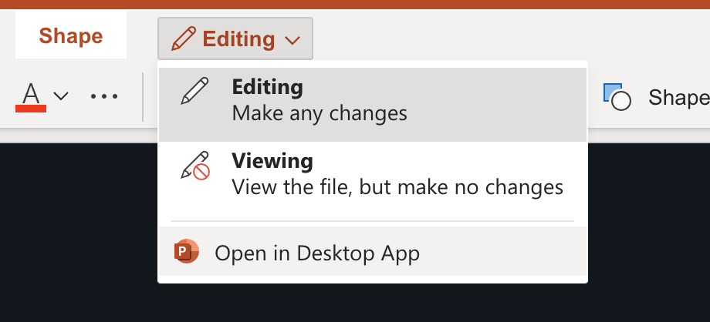
Note It’s best to work with this file in Powerpoint on Desktop
You can't see sections in the web version :-(
If you are not signed in to Microsoft account, please sign in first. Signing in with an account helps others know what changes you are making and helps better collaborate.
The click on the “Editing” dropdown and select Open in Desktop App
Note: If you are not signed in this option will not appear.
If you do not have a Desktop Powerpoint application you may continue to use this browser version.
All the best!

Slide 2




License
This work is licensed under a Creative Commons Attribution-NonCommercial-NoDerivatives 4.0 International.
This license requires that reusers give credit to the creator. It allows reusers to copy and distribute the material in any medium or format in unadapted form and for noncommercial purposes only.
BY: Credit must be given to you, the creator.
NC: Only noncommercial use of your work is permitted.
Noncommercial means not primarily intended for or directed towards commercial advantage or monetary compensation.
ND: No derivatives or adaptations of your work are permitted.

Slide 3

Attribution
When using this material, please credit KodeKloud as follows: "This training material is provided by KodeKloud (https://kodekloud.com) under the Creative Commons Attribution-NonCommercial 4.0 International License."
We would be absolutely thrilled if you took a selfie with your class and share it on social media while tagging us.

Slide 4

Linux for Beginners

Slide 5











Log into local and remote systems
System documentation
Working with files and directories
Create and manage hard and soft links
Standards file permissions
Searching files using GREP
What you will learn:
Basic and extended regular expressions
User accounts and groups
Resource Limits
User privileges
Manage the root account
Notes:
During the course, we’ll cover each of the topics you’ll need to know for the LFCS exam, from the six domains of knowledge it includes:
1: Essential commands Which will cover logging into Linux systems and working with files and directories.
2: Operation of running systems Where we'll explore the system boot process, task automation, and managing critical resources and processes.
3:User and group management Which will not only cover creating and managing user and group accounts, but also setting resource quotas and configuring advanced authentication options.
4: Networking Where we will learn to work with network services, routing, and packet filtering.
5:Service configuration Which will cover setting up Linux to host necessary services, such as DNS, SSH, web servers, and mail servers.
6: And storage management In which we will learn to set up logical volume management, RAID, and encrypted storage, as well as advanced file system permissions.

Slide 6
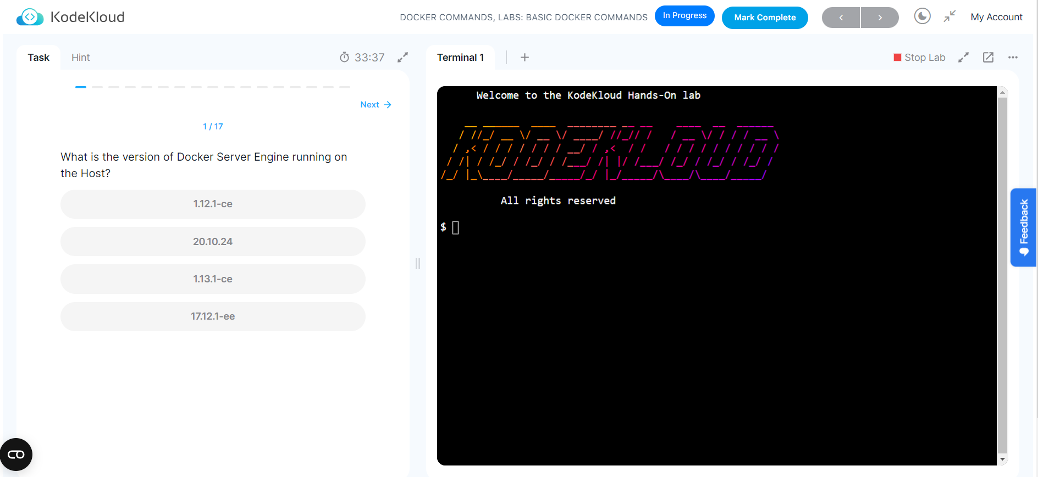
Access FREE KodeKloud hands-on labs for better learning experience.
Tap on this Link and SignUp for Linux labs course

Slide 7


Login Methods
Local text-mode console
Remote text-mode login
Local graphical-mode console
Remote graphical-mode login
Notes:
So, let's dive right in and start with some simple concepts.
We're all used to logging in to apps or websites by providing a username and password. Logging into a Linux system is pretty much the same, so there's not much mystery here. We'll look at four ways to log in:
Log into a local Linux system (local text-mode console).
Log into a local Linux system (local graphical-mode console).
Log into a remote Linux system (text-mode login)
Log into a remote Linux system (graphical-mode login)

Slide 8
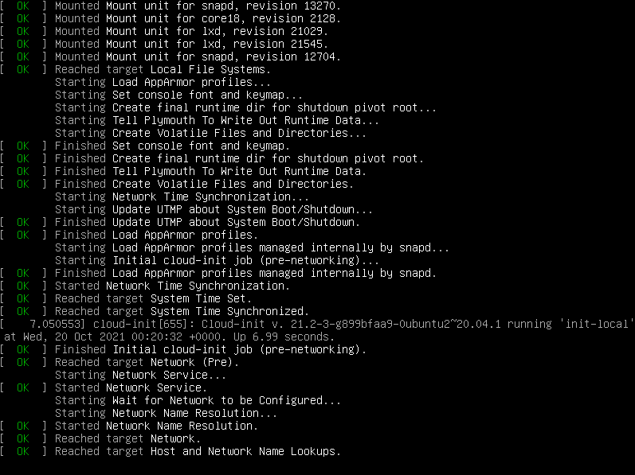
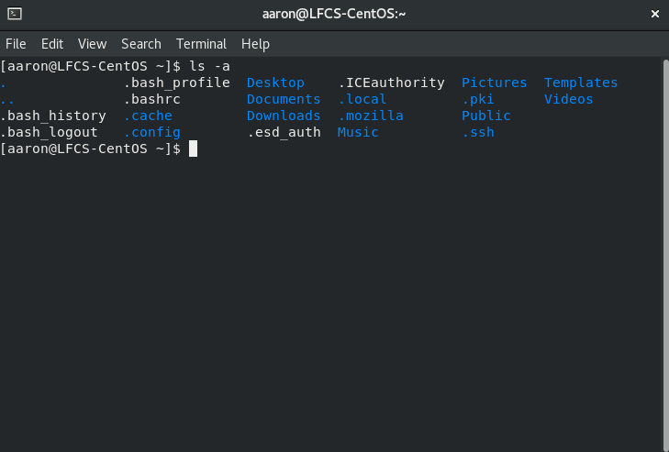
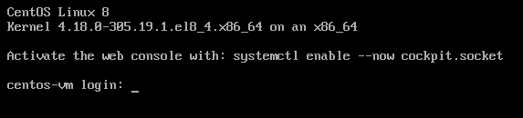
Console
Virtual Terminal
Terminal Emulator
Notes:
You'll often hear terms like "console", "virtual terminal", and "terminal emulator". And it may be hard to understand why they are called this way.
Nowadays, a "console" is just a screen where your operating system displays some text and where it allows you to log in or type commands. And a terminal emulator is nothing more than a graphical app that runs in a window and does a similar thing (shows you text output and allows you to type commands). These terms come from the old days of computing.

Slide 9

Consoles
Notes:
Computers were incredibly expensive, so a university may have had a single one available for their entire building.
But multiple people could connect to it and do their work by using physical devices that allowed them to type text and commands and also display on a screen what is currently happening. These devices were consoles or terminals. So instead of buying 25 super expensive computers, you could have just one, but 25 people could use it, even at the same time.
Nowadays, consoles and terminals, in Linux, are usually things that exist in software, rather than hardware. For example:
When you see Linux boot and a bunch of text appears on screen, telling you what happens as the operating system is loading - that's the console.

Slide 10
Consoles
Notes:
Computers were incredibly expensive, so a university may have had a single one available for their entire building.
But multiple people could connect to it and do their work by using physical devices that allowed them to type text and commands and also display on a screen what is currently happening. These devices were consoles or terminals. So instead of buying 25 super expensive computers, you could have just one, but 25 people could use it, even at the same time.
Nowadays, consoles and terminals, in Linux, are usually things that exist in software, rather than hardware. For example:
When you see Linux boot and a bunch of text appears on screen, telling you what happens as the operating system is loading - that's the console.

Slide 11
Virtual Terminals
CTRL
+
ALT
+
F2
Notes:
After a Linux machine has booted, if you press CTRL+ALT+F2 on the keyboard, you'll see a virtual terminal (vt2).

Slide 12
Terminal Emulators
Notes:
If you have Linux installed on your desktop, with a graphical user interface, when you want to type commands you open a terminal emulator.
Let's move back to logins. In practice, most often you'll log in to remote Linux systems. But let's start with the less common scenarios.

Slide 13
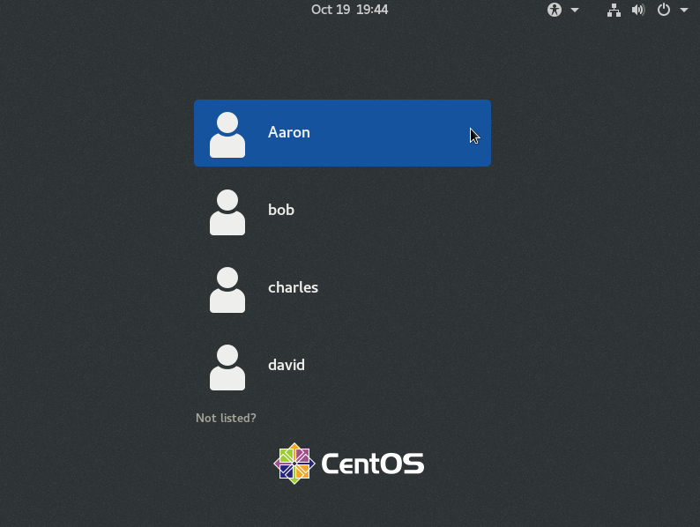
Local GUI
Notes:
"Local" is just a tech word for "something that is in front of you" or "something you can physically access". A computer on your desk is local. A server running on Google Cloud is remote.
Usually, when Linux is installed on servers, it is installed without GUI (Graphical User Interface) components. There's no mouse pointer, no buttons, no windows, no menus, nothing of that sort, just text. But you might sometimes run across servers that include this GUI. Logging in is super easy, as it's all "in your face". You'll see a list of users you can choose from and you can then type your user's password.
Don't forget to log out when you've finished your work.

Slide 14
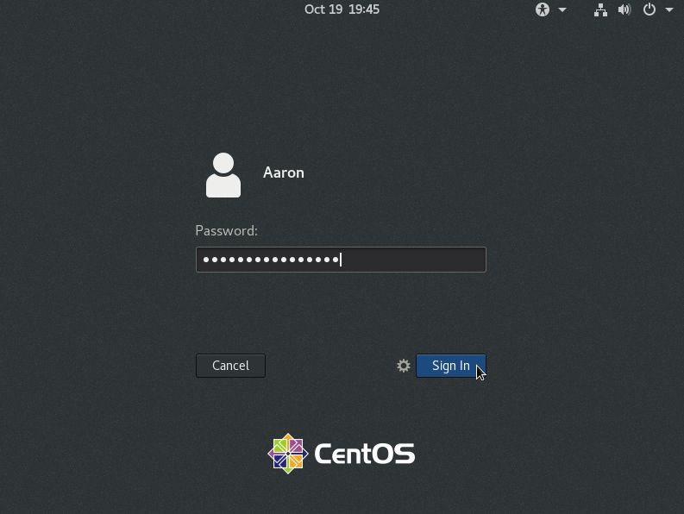
Local GUI
Notes:
"Local" is just a tech word for "something that is in front of you" or "something you can physically access". A computer on your desk is local. A server running on Google Cloud is remote.
Usually, when Linux is installed on servers, it is installed without GUI (Graphical User Interface) components. There's no mouse pointer, no buttons, no windows, no menus, nothing of that sort, just text. But you might sometimes run across servers that include this GUI. Logging in is super easy, as it's all "in your face". You'll see a list of users you can choose from and you can then type your user's password.
Don't forget to log out when you've finished your work.

Slide 15
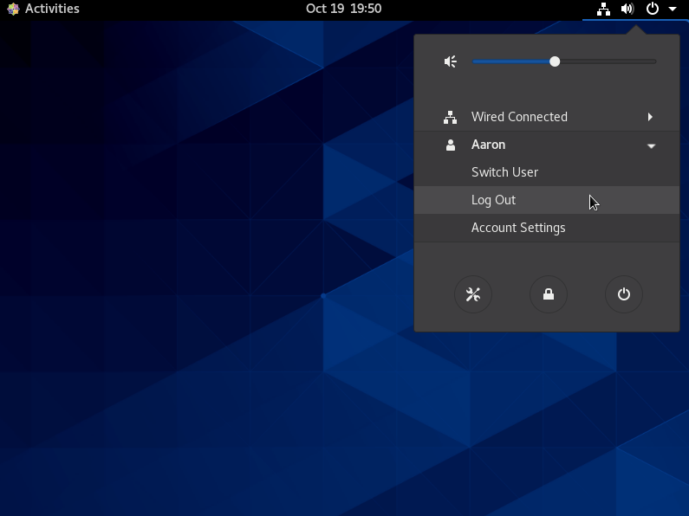
Local GUI
Notes:
"Local" is just a tech word for "something that is in front of you" or "something you can physically access". A computer on your desk is local. A server running on Google Cloud is remote.
Usually, when Linux is installed on servers, it is installed without GUI (Graphical User Interface) components. There's no mouse pointer, no buttons, no windows, no menus, nothing of that sort, just text. But you might sometimes run across servers that include this GUI. Logging in is super easy, as it's all "in your face". You'll see a list of users you can choose from and you can then type your user's password.
Don't forget to log out when you've finished your work.

Slide 16
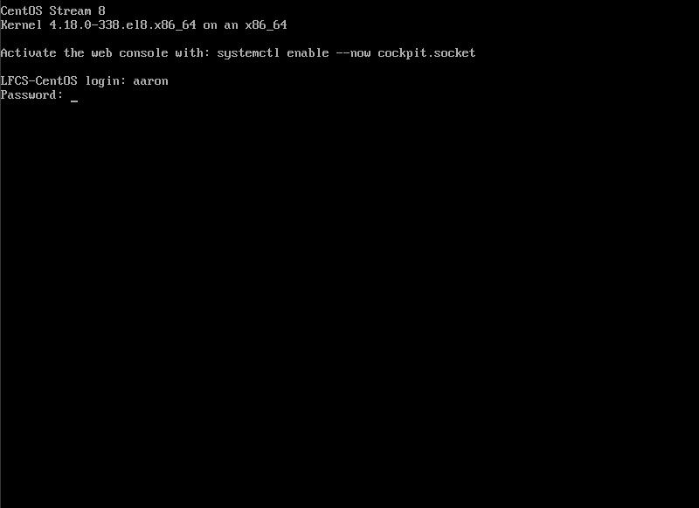
Local text console
Notes:
If the device has the typical server-oriented Linux OS installed, without any GUI components, logging in (locally) is also easy. You'll usually see something like this on your screen:
There's no list of users this time, but you can just type your username and then your password. Note that you won’t see your password as you type.
When your work is done, you should type exit to log out.

Slide 17
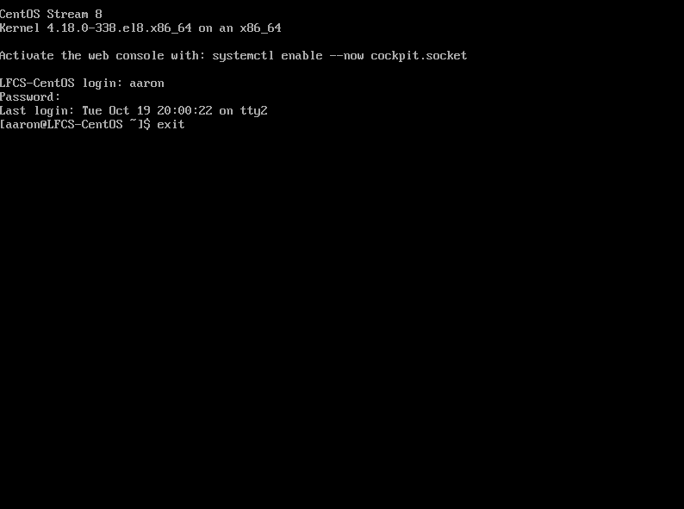
Local text console
Notes:
If the device has the typical server-oriented Linux OS installed, without any GUI components, logging in (locally) is also easy. You'll usually see something like this on your screen:
There's no list of users this time, but you can just type your username and then your password. Note that you won’t see your password as you type.
When your work is done, you should type exit to log out.

Slide 18


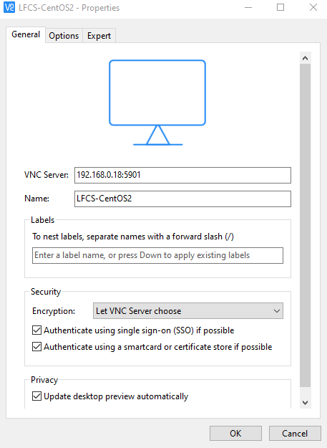
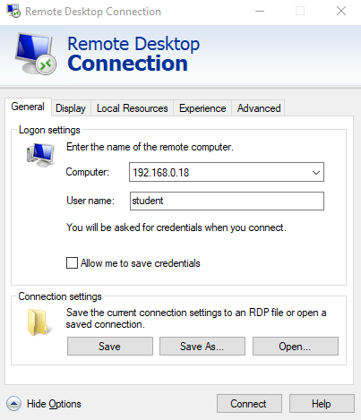
Remote GUI
VNC
RDP
Notes:
Again, most Linux operating systems running on servers will have no GUI components installed. But you will sometimes run into exceptions. Connecting to a remote server, to its graphical user interface is slightly more tricky. First of all, there is no standard set in stone. Whoever configured that server chose their preferred way of dealing with these remote graphical logins. They could have chosen to install a VNC (Virtual Network Computing) solution. In this case, you'd need to download the proper VNC client (also called "VNC viewer") to connect to it. This might be TightVNC or RealVNC or something else entirely. It all depends on the VNC server running on the remote system and what VNC clients your local operating system supports.
If the administrator of that server wanted to let Windows users connect easily, it might mean that they used a solution allowing for RDP connections (Remote Desktop Protocol). This means you can just click on Windows' start button, type "Remote Desktop Connection", open that app and then enter the username and password you've been provided.
Whatever it might be, connecting to a remote graphical console is pretty easy. It all boils down to downloading the application that lets you do that, entering the remote system's IP address, followed by an username and a password.

Slide 19


Remote text-mode login
SSH
Secure SHell
telnet
Notes:
Initiating a text-based remote connection to a Linux system is pretty standard. That's because almost every Linux server uses the same tool that allows for remote logins: the OpenSSH daemon (program that runs in the background, on the server, all the time). SSH comes from Secure SHell. Until SSH, something called telnet was the standard. telnet was highly insecure as it did not encrypt communication between you and the server you were connecting to. This meant that anyone on the same network with you could steal your Linux user password and see everything you did on that server, during your telnet session. The SSH protocol uses strong encryption to avoid this and the OpenSSH daemon is built carefully to avoid security bugs as much as possible. Long story short, OpenSSH is used by millions of servers and has stood the test of time, proving to be very hard to hack. For these reasons everyone happily uses it and trusts that it can do a pretty good job at only letting authorized people log into their operating systems, while keeping bad people out.

Slide 20

SSH login
>_
$ ip a
Server
1: lo: <LOOPBACK,UP,LOWER_UP> mtu 65536 qdisc noqueue state UNKNOWN group default qlen 1000
link/loopback 00:00:00:00:00:00 brd 00:00:00:00:00:00
inet 127.0.0.1/8 scope host lo
valid_lft forever preferred_lft forever
inet6 ::1/128 scope host
valid_lft forever preferred_lft forever
2: enp0s3: <BROADCAST,MULTICAST,UP,LOWER_UP> mtu 1500 qdisc fq_codel state UP group default qlen 1000
link/ether 08:00:27:6b:d7:87 brd ff:ff:ff:ff:ff:ff
inet 192.168.0.17/24 brd 192.168.0.255 scope global dynamic noprefixroute enp0s3
valid_lft 1966sec preferred_lft 1966sec
inet6 fe80::a00:27ff:fe6b:d787/64 scope link noprefixroute
SSH daemon
Computer
SSH client
Notes:
In case you're following along on your virtual machine, log in locally (directly from the virtual machine window) and then enter this command: (ip a) You'll see what IP your machine uses. I’ve outlined the information we’re looking for in yellow.
We'll use this IP – in our case 192.168.0.17 -- to simulate a situation where we have a server in a remote location. Now to recap. We have an SSH daemon (program) running on the server. This listens for any incoming connections. To be able to connect to this remote SSH daemon, we'll need something called an SSH client (yet another program). This client will run on our current laptop/desktop computer.

Slide 21
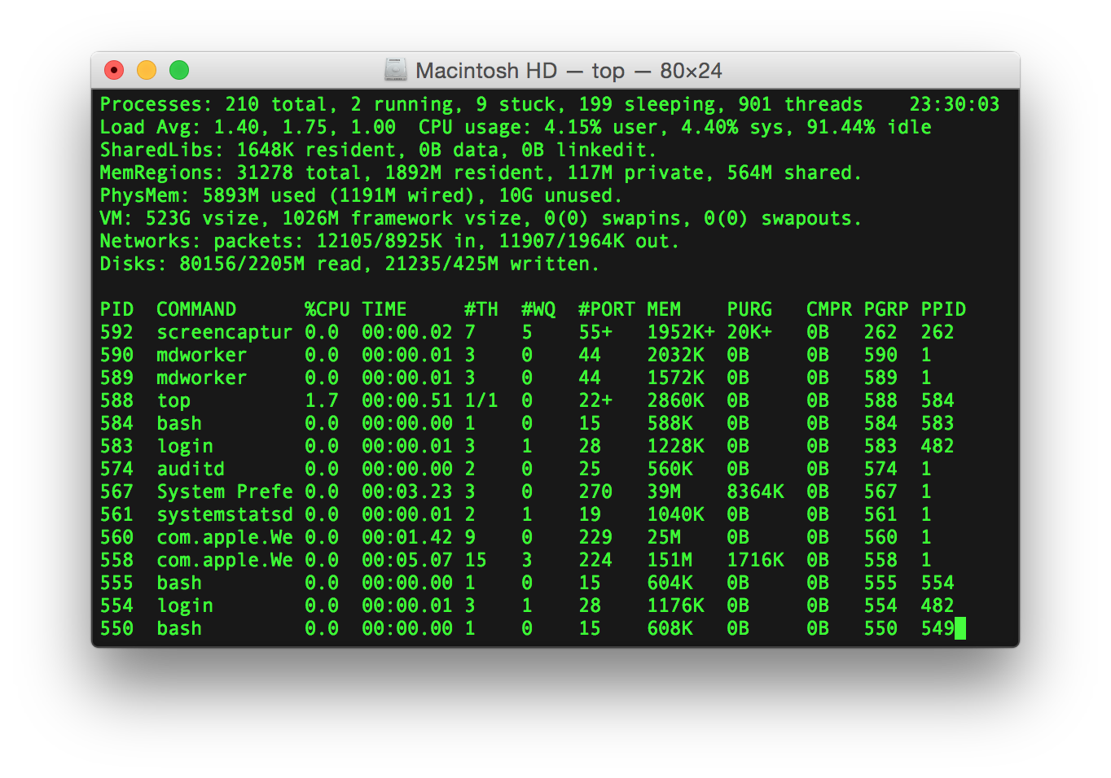
MacOS & Linux
Notes:
MacOS systems and Linux-based operating systems, such as Ubuntu, already have an SSH client preinstalled. If you're on MacOS or Linux, open a terminal emulator window.

Slide 22
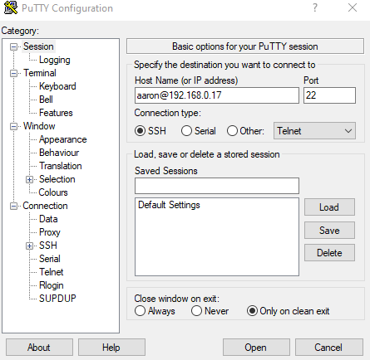
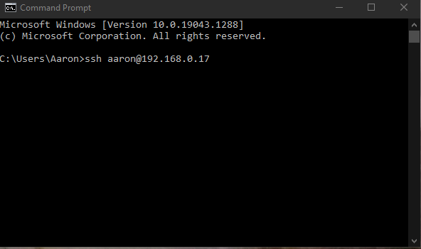
Windows
Notes:
In the past, if you were running Windows, you needed to install an SSH client like PuTTY. On the latest Windows 10 this is no longer necessary as an SSH client is also preinstalled. If you're on Windows, click the Start Menu and type "cmd" to open up Command Prompt.

Slide 23
SSH
>_
$ ssh aaron@192.168.0.17
aaron@192.168.0.17's password:
Activate the web console with: systemctl enable --now cockpit.socket
Last login: Tue Oct 19 20:27:15 2021 from 192.168.0.3
[aaron@LFCS-CentOS ~]$
Notes:
To connect to a remote Linux system through SSH, type:
Of course, replace "aaron" with the actual username you created inside your Linux OS running in the virtual machine. Same with the IP address. From here on, we'll stay inside this SSH session to go through all the exercises in the upcoming lessons. Please join me in the demonstration video to see each of these login methods. I’ll see you there.

Slide 24
Note It’s best to work with this file in Powerpoint on Desktop
You can't see sections in the web version :-(
If you are not signed in to Microsoft account, please sign in first. Signing in with an account helps others know what changes you are making and helps better collaborate.
The click on the “Editing” dropdown and select Open in Desktop App
Note: If you are not signed in this option will not appear.
If you do not have a Desktop Powerpoint application you may continue to use this browser version.
All the best!

Slide 25

Read and Use System
Documentation
© Copyright KodeKloud
Notes:
There will be many commands we will use in Linux. And each command has a lot of command line switches. How are we supposed to remember them all?
As we use a command repeatedly, we'll learn everything about it and memorize what each option does. But in the beginning, we might forget about these options after just one or two uses. That's why Linux gives you multiple ways to access "help manuals" and documentation, right at the command line.

Slide 26
--help
$ ls --help
Usage: ls [OPTION]... [FILE]...
List information about the FILEs (the current directory by default).
Sort entries alphabetically if none of -cftuvSUX nor --sort is specified.
Mandatory arguments to long options are mandatory for short options too.
-a, --all do not ignore entries starting with .
-A, --almost-all do not list implied . and ..
-B, --ignore-backups do not list implied entries ending with ~
-I, --ignore=PATTERN do not list implied entries matching shell PATTERN
-k, --kibibytes default to 1024-byte blocks for disk usage
-l use a long listing format
-c with -lt: sort by, and show, ctime (time of last
modification of file status information);
with -l: show ctime and sort by name;
otherwise: sort by ctime, newest first
$ ls -l
bin/ libexec/ sbin/
lib/ local/ share/
Notes:
Let's say you want to see that long listing format with ls, to get a look at file permissions. But you forgot what the correct option was. Was it -p for permissions? We can get a quick reminder with:
ls --help
This will show us a lot of output. But if we scroll up, we'll find what we're looking for: the –l flag, in this case.
You can see how command line options are sorted alphabetically and described with short text. That's why the --help option for commands will very often be helpful when we forget about these options (and we will, as there are so many of them for each command).

Slide 27


--help
$ journalctl --help
journalctl [OPTIONS...] [MATCHES...]
Query the journal.
Options:
--system Show the system journal
--user Show the user journal for the current user
-M --machine=CONTAINER Operate on local container
-S --since=DATE Show entries not older than the specified date
-U --until=DATE Show entries not newer than the specified date
-c --cursor=CURSOR Show entries starting at the specified cursor
--after-cursor=CURSOR Show entries after the specified cursor
--show-cursor Print the cursor after all the entries
-b --boot[=ID] Show current boot or the specified boot
--list-boots Show terse information about recorded boots
lines 1-27
PAGEUP
PAGE DOWN
q
Notes:
--help will usually show a condensed form of help, with very short explanations. For ls, that's ok, as it's a very simple command. Other commands, however, are very complex and we need to read longer explanations to understand what they do and how we use them.
Let's take journalctl as an example, a command that lets us read system logs.
journalctl --help
will show us this:
We'll notice that this opens in a slightly different way (look at "lines 1-27") in the bottom left corner. This opened in what Linux calls a "pager". It's simply a "text viewer" of sorts that lets us scroll up and down with our arrow keys or PAGE UP, PAGE DOWN. To exit this help page, press q.

Slide 28
Manual Pages With man Command
$ man journalctl
JOURNALCTL(1) journalctl JOURNALCTL(1)
NAME
journalctl - Query the systemd journal
SYNOPSIS
journalctl [OPTIONS...] [MATCHES...]
DESCRIPTION
journalctl may be used to query the contents of the systemd(1) journal as written by systemd-
journald.service(8).
If called without parameters, it will show the full contents of the journal, starting with the oldest entry
collected.
If one or more match arguments are passed, the output is filtered accordingly. A match is in the format
"FIELD=VALUE", e.g. "_SYSTEMD_UNIT=httpd.service", referring to the components of a structured journal entry.
See systemd.journal-fields(7) for a list of well-known fields. If multiple matches are specified matching
different fields, the log entries are filtered by both, i.e. the resulting output will show only entries
matching all the specified matches of this kind. If two matches apply to the same field, then they are
automatically matched as alternatives, i.e. the resulting output will show entries matching any of the
specified matches for the same field. Finally, the character "+" may appear as a separate word between other
terms on the command line. This causes all matches before and after to be combined in a disjunction (i.e.
logical OR).
Notes:
All important commands in Linux have their own manuals or "man pages". To access a command's manual enter "man name_of_command". In our case, we'd use:
man journalctl
Now we get:
Short description of what the command does in NAME.
General syntax of command in SYNOPSIS
Detailed description of command, how it works, and so on, in DESCRIPTION.
Detailed descriptions of command line options in OPTIONS.
And some manual pages even have some EXAMPLES near the end of the manual.

Slide 29
Manual Pages With man Command
$ man journalctl
EXAMPLES
Without arguments, all collected logs are shown unfiltered:
journalctl
With one match specified, all entries with a field matching the expression are shown:
journalctl _SYSTEMD_UNIT=avahi-daemon.service
If two different fields are matched, only entries matching both expressions at the same time are shown:
journalctl _SYSTEMD_UNIT=avahi-daemon.service _PID=28097
If two matches refer to the same field, all entries matching either expression are shown:
journalctl _SYSTEMD_UNIT=avahi-daemon.service _SYSTEMD_UNIT=dbus.service
If the separator "+" is used, two expressions may be combined in a logical OR. The following will show all
messages from the Avahi service process with the PID 28097 plus all messages from the D-Bus service (from any
of its processes):
journalctl _SYSTEMD_UNIT=avahi-daemon.service _PID=28097 + _SYSTEMD_UNIT=dbus.service
JOURNALCTL(1) journalctl JOURNALCTL(1)
NAME
journalctl - Query the systemd journal
SYNOPSIS
journalctl [OPTIONS...] [MATCHES...]
DESCRIPTION
journalctl may be used to query the contents of the systemd(1) journal as written by systemd-
journald.service(8).
If called without parameters, it will show the full contents of the journal, starting with the oldest entry
collected.
If one or more match arguments are passed, the output is filtered accordingly. A match is in the format
"FIELD=VALUE", e.g. "_SYSTEMD_UNIT=httpd.service", referring to the components of a structured journal entry.
See systemd.journal-fields(7) for a list of well-known fields. If multiple matches are specified matching
different fields, the log entries are filtered by both, i.e. the resulting output will show only entries
matching all the specified matches of this kind. If two matches apply to the same field, then they are
automatically matched as alternatives, i.e. the resulting output will show entries matching any of the
specified matches for the same field. Finally, the character "+" may appear as a separate word between other
terms on the command line. This causes all matches before and after to be combined in a disjunction (i.e.
logical OR).
Notes:
All important commands in Linux have their own manuals or "man pages". To access a command's manual enter "man name_of_command". In our case, we'd use:
man journalctl
Now we get:
Short description of what the command does in NAME.
General syntax of command in SYNOPSIS
Detailed description of command, how it works, and so on, in DESCRIPTION.
Detailed descriptions of command line options in OPTIONS.
And some manual pages even have some EXAMPLES near the end of the manual.

Slide 30
Manual Pages With man Command
$ man man
The table below shows the section numbers of the manual followed by the types
of pages they contain.
1 Executable programs or shell commands
2 System calls (functions provided by the kernel)
3 Library calls (functions within program libraries)
4 Special files (usually found in /dev)
5 File formats and conventions eg /etc/passwd
6 Games
7 Miscellaneous (including macro packages and conventions), e.g. man(7),
groff(7)
8 System administration commands (usually only for root)
9 Kernel routines [Non standard]
$ man 1 printf
$ man 3 printf
Notes:
Sometimes, you will have two man pages with the same name. Example:
printf is a command. But printf is also a function that can be used by programmers.
Manual pages can fall into one of these categories (sections), and we can see these by looking at the man page for man itself, by typing man man:
If you want to read the man page about printf, the command, you tell man you want to consult printf from section 1, like this
man 1 printf
If you want to read about printf, the function, you tell man you want to look at section 3
man 3 printf
It's useful to know that during online exams, the Linux Foundation will let you use man and --help. Try to use --help if you forgot a command line option as that gives you the fastest results. Diving deep into a manual page will eat up more time.
But this is all well and good when we know what command we want to explore. But what if we can't even remember the name of the command that we need to use?

Slide 31
Searching For Commands - apropos
$ apropos director
$ apropos director
directory
directories
ls (1) - list directory contents
ls (1p) - list directory contents
mcd (1) - change MSDOS directory
mdeltree (1) - recursively delete an MSDOS directory and its contents
mdir (1) - display an MSDOS directory
mdu (1) - display the amount of space occupied by an MSDOS direc...
mkdir (1) - make directories
mkdir (1p) - make directories
mkdir (2) - create a directory
mkdir (3p) - make a directory relative to directory file descriptor
mkdirat (2) - create a directory
$ apropos director
director: nothing appropriate
$ sudo mandb
Notes:
Imagine you forgot the name of the command that lets you create a new directory. How would you search for it?
apropos is a command that lets you search through man pages. It looks at the short descriptions of each man page and tries to see if it matches the text we entered. For example, with the next line we can search for all man pages that have the word "director" in their short descriptions. We'll use "director" and not "directory". "director" will match commands that contain the word "directory" but also the ones that contain "directories". So, we keep it more generic this way.
The first time we would run apropos director, we’d get an error.
That’s because apropos relies on a database. A program must refresh it periodically. Since we just started this virtual machine, the database hasn't been created yet. We can create it manually with:
sudo mandb
On servers that have already run for days, there should be no need to do this, as it will be done automatically.
Now the apropos command should work:
apropos director
If we scroll up, we can see the entry we’re looking for: mkdir.

Slide 32
Searching For Commands - apropos
$ apropos director
$ apropos –s 1,8 director
ls (1) - list directory contents
ls (1p) - list directory contents
mcd (1) - change MSDOS directory
mdeltree (1) - recursively delete an MSDOS directory and its contents
mdir (1) - display an MSDOS directory
mdu (1) - display the amount of space occupied by an MSDOS direc...
mkdir (1) - make directories
mkdir (1p) - make directories
mkdir (2) - create a directory
mkdir (3p) - make a directory relative to directory file descriptor
mkdirat (2) - create a directory
ls (1) - list directory contents
mcd (1) - change MSDOS directory
mdeltree (1) - recursively delete an MSDOS directory and its contents
mdir (1) - display an MSDOS directory
mdu (1) - display the amount of space occupied by an MSDOS direc...
mkdir (1) - make directories
Sections 1 and 8
Notes:
But those are a lot of entries. Makes it hard to spot what we're looking for. You see, apropos doesn't just list commands. It also lists some other things we don't need, currently. We see stuff like (2). That signals that that entry is in section 2 of the man pages (system calls provided by the Linux kernel). That's just too advanced for our purposes. Commands will be found in sections 1 and 8. We can tell apropos to only filter out results that lead to commands from these categories. We do this by using the -s option, followed by a list of the sections we need.
apropos -s 1,8 director
And we can spot what we were looking for more easily.
Notice how mkdir's description contains the word "directories". If we'd have used the word "directory" in our apropos search, this command wouldn't have appeared since "directory" wouldn't have matched "directories". This is something to keep in mind when you want to make your searches as open as possible and match more stuff.

Slide 33
$ systemc
tl
TAB
TAB
TAB
add-requires emergency isolate poweroff show
add-wants enable is-system-running preset show-environment
cancel exit kexec reboot start
cat force-reload kill reenable status
condreload get-default link reload stop
condrestart halt list-dependencies reload-or-restart suspend
condstop help list-jobs rescue switch-root
$ systemctl list-dep
TAB
endencies
Notes:
Another thing that’ll save a lot of time is autocompletion. Type
systemc
press TAB
you get:
systemctl
Although this is not technically system documentation, it can still be helpful. Many commands have suggestions on what you can type next. For example, try this. Type
systemctl
add a space after the command (don't press ENTER) and now press TAB twice.
You get a huge list of suggestions. This can help you figure out what your options for that command are. Although you should not always rely on it. It's not necessary that absolutely all options are included in this suggestion list.
now add to that:
systemctl list-dep
press TAB
endencies will get added at the end and you get: systemctl list-dependencies. This is TAB autocompletion and many commands support it. When you press TAB once, if your command interpreter can figure out what you want to do, it will automatically fill in the letters. If there are many autocomplete options and it can't figure out which one you want, press TAB again and it will show the list of suggestions we observed earlier. These will be huge timesavers in the long-run, and they might even help you in the exam, to shave off a few seconds here and there, which might add up and let you explore an extra question or two.

Slide 34
TAB: Suggest and Autocomplete
sr/
$ ls /u
TAB
TAB
TAB
bin/ libexec/ sbin/
lib/ local/ share/
Notes:
TAB suggestions and autocompletions also work for filenames or directory names. Try
ls /u TAB
ls /usr/ TAB TAB
Now we can see directories available in /usr/ without even needing to explore this directory with "ls" beforehand. And if we have a long filename like "wordpress_archive.tgz" we might be able to just type "wor", press TAB and that long name will be autocompleted.
Recommendation
While manuals and --help pages are super useful, the first few times you use them, it might be hard to figure out how to do something, with that info alone. We recommend you take a command you know nothing about and try to figure out with just man and --help, how to do something. This practice will help you develop the ability to quickly look for help when you're taking the LFCS exam. There will be questions about theory you either don't know about, or you just forgot. If you know how to quickly figure out the answer with a man page or --help, you'll be able to pass the exam much more easily.

Slide 35

It's time to do a hands-on lab on
Logging in and System Documentation
Tap on this Link to access the lab

Slide 36
Note It’s best to work with this file in Powerpoint on Desktop
You can't see sections in the web version :-(
If you are not signed in to Microsoft account, please sign in first. Signing in with an account helps others know what changes you are making and helps better collaborate.
The click on the “Editing” dropdown and select Open in Desktop App
Note: If you are not signed in this option will not appear.
If you do not have a Desktop Powerpoint application you may continue to use this browser version.
All the best!

Slide 37

Working With Files
and Directories
© Copyright KodeKloud
Notes:
Now we’ll look at how to create, delete, copy, and move files and directories in Linux. Before we dive into this lesson, we need to understand a few basic things:
What is a filesystem tree?
What is an absolute path?
What is a relative path?

Slide 38
Listing Files and Directories
$ ls
ls list
Pictures Desktop
Documents Videos
Downloads Music
$ ls -a
-a all
.
..
.ssh
.bash_logout
.bash_profile
.bashrc
Pictures
Desktop Documents Videos
Downloads Music
Notes:
To list files and directories in your current (working) directory, we use the ls command in Linux. Using ls in your home directory might look like this:
ls comes from list.
On Linux, files and directories can have a name that begins with a . Example: the ".ssh" directory. These won't be displayed by a simple ls command. They are, in a way, hidden.
To list all files and directories, even the ones beginning with a ., use ls –a (the –a flag comes from the word all.)

Slide 39
Listing Files and Directories
$ ls –l /var/log/
total 4064
drwxr-xr-x. 2 root root 4096 Oct 18 22:52 anaconda
drwx------. 2 root root 23 Oct 18 22:53 audit
-rw-------. 1 root root 19524 Nov 1 17:56 boot.log
-rw-rw----. 1 root utmp 0 Nov 1 14:08 btmp
-rw-rw----. 1 root utmp 0 Oct 18 22:38 btmp-20211101
drwxr-x---. 2 chrony chrony 6 Jun 24 09:21 chrony
-rw-------. 1 root root 9794 Nov 1 18:01 cron
-rw-------. 1 root root 10682 Oct 26 14:01 cron-20211026
drwxr-xr-x. 2 lp sys 135 Oct 26 14:13 cups
-rw-r--r--. 1 root root 35681 Nov 1 18:13 dnf.rpm.log
-rw-r-----. 1 root root 4650 Nov 1 17:56 firewalld
drwx--x--x. 2 root gdm 6 Oct 19 00:07 gdm
drwxr-xr-x. 2 root root 6 Aug 31 12:07 glusterfs
Notes:
Of course, to list files and directories from a different location, we just type the directory path at the end of ls, like ls /var/log/ or ls -l /var/log/ to list files and directories in a different format, called a "long listing format," which shows us more details for each entry, like the permissions for a file or directory, what user/group owns each entry, when it was last modified.

Slide 40
Listing Files and Directories
$ ls –a -l
$ ls –al
total 76
drwx------. 16 aaron aaron 4096 Nov 1 17:57 .
drwxr-xr-x. 7 root root 70 Oct 26 16:54 ..
-rw-------. 1 aaron aaron 5085 Nov 1 17:56 .bash_history
-rw-r--r--. 1 aaron aaron 18 Jul 27 09:21 .bash_logout
-rw-r--r--. 1 aaron aaron 141 Jul 27 09:21 .bash_profile
-rw-r--r--. 1 aaron aaron 376 Jul 27 09:21 .bashrc
drwxr-xr-x. 2 aaron aaron 6 Oct 19 00:11 Desktop
drwxr-xr-x. 3 aaron aaron 25 Oct 23 18:15 Documents
drwxr-xr-x. 2 aaron aaron 6 Oct 19 00:11 Downloads
drwxr-xr-x. 2 aaron aaron 6 Oct 19 00:11 Music
drwxr-xr-x. 2 aaron aaron 28 Oct 26 13:37 Pictures
-rw-rw-r--. 1 aaron aaron 36 Oct 28 20:06 testfile
Notes:
We can combine the -a and -l command line options like this:
ls -a –l or like this as ls –al.
This will display entries in long listing format and also show us "pseudo-hidden" files and directories which have a name beginning with a . It doesn’t matter which order you put the flags, and you don’t have to put a – in front of each of them. However, the last form is preferred as it's faster to write it.

Slide 41
Listing Files and Directories
$ ls –alh
-h human readable format
total 76K
drwx------. 16 aaron aaron 4.0K Nov 1 17:57 .
drwxr-xr-x. 7 root root 70 Oct 26 16:54 ..
-rw-------. 1 aaron aaron 5.0K Nov 1 17:56 .bash_history
-rw-r--r--. 1 aaron aaron 18 Jul 27 09:21 .bash_logout
-rw-r--r--. 1 aaron aaron 141 Jul 27 09:21 .bash_profile
-rw-r--r--. 1 aaron aaron 376 Jul 27 09:21 .bashrc
drwxr-xr-x. 2 aaron aaron 6 Oct 19 00:11 Desktop
drwxr-xr-x. 3 aaron aaron 25 Oct 23 18:15 Documents
drwxr-xr-x. 2 aaron aaron 6 Oct 19 00:11 Downloads
drwxr-xr-x. 2 aaron aaron 6 Oct 19 00:11 Music
drwxr-xr-x. 2 aaron aaron 28 Oct 26 13:37 Pictures
-rw-rw-r--. 1 aaron aaron 36 Oct 28 20:06 testfile
Notes:
There's also a command line option, -h, that shows sizes in "human readable format": bytes, kilobytes, megabytes, and so on. This must be combined with the -l option. If we want to use three options, we could use ls –alh.

Slide 42
Filesystem Tree
/
home
var
aaron
jane
log
Documents
Invoice.pdf
Notes:
Linux organizes files and directories in what it calls the filesystem tree. Why is it called the filesystem tree? Because just like a tree we'd see in nature, this also has a root, branches and leaves. Except, Linux's filesystem tree is inverted. The root is at the top and its branches and leaves "grow" downward.

Slide 43
Filesystem Tree
/
home
var
aaron
jane
log
directory path
Documents
file path
Invoice.pdf
Notes:
The root directory is /. This is the top-level directory, there can be no other directories above it. Under / there are a few subdirectories like home, var, etc, and so on. These subdirectories may also contain other subdirectories themselves. To access a file or directory on our command line, we must specify its file path or directory path. This path can be written in two different ways:

Slide 44
Absolute Path
/
/
home
/aaron
/Documents
/Invoice.pdf
home
var
aaron
jane
log
Documents
Invoice.pdf
Notes:
The easiest to understand is the absolute path.
/home/aaron/Documents/Invoice.pdf is an example of such a path.
Absolute paths always start out with the root directory, represented by /. Then we specify the subdirectories we want to descend into, in this case, first home, then aaron, then Documents. We can see the subdirectory names are separated by a /. And we finally get to the file we want to access, Invoice.pdf.
An absolute path can end with the name of a file, but also with the name of a directory. If we'd want to refer to the Documents directory, we'd specify a path like /home/aaron/Documents

Slide 45
Current / Working Directory
/
$ pwd
print working directory
/root
home
var
root
aaron
jane
log
Documents
Invoice.pdf
Notes:
To understand a relative path, we first must explore what the current directory means. This is also called the working directory.
To see our current (working) directory we can type
pwd
pwd = Print Working Directory
When we're working at the command line, we're always "inside" a directory. For example, if we log in as the user "aaron" on some server, our starting current directory might be /home/aaron. Every user starts in its home directory when they log in. jane might have it at /home/jane, and root (the super user/administrator) has it at /root.

Slide 46
Current / Working Directory
/
change directory
$ cd /var/log
$ cd /home/aaron
home
var
root
$ cd ..
.. = parent directory
aaron
jane
log
Documents
Invoice.pdf
Notes:
To change our current directory, we use the cd command (change directory).
cd /var/log
would change our current directory to /var/log. We used an absolute path here. But we can also change directory this way:
cd ..
This will take us one directory UP.
If we were cd into /home/aaron, running “cd ..” would take us into /home, which becomes the new current directory.
“..” always refers to the parent directory of our current directory. This was an example of using a very simple relative path. Let's dive deeper.

Slide 47
Relative Path
/
Invoice.pdf
$ Documents/Invoice.pdf
$ Invoice.pdf
home
var
Invoice.pdf
$ ../Invoice.pdf
aaron
log
$ ../../Invoice.pdf
Invoice.pdf
Documents
Invoice.pdf
Notes:
Let's imagine our current directory is /home/aaron. With relative paths we can refer to other places in one of three main ways
Locations "under" our current directory. E.g., Documents/Invoice.pdf Since we're in /home/aaron, typing a path like Documents/Invoice.pdf is like typing /home/aaron/Documents/Invoice.pdf. Our relative path "gets added" to our current directory and we get to our PDF file.
Locations in our current directory. Typing Invoice.pdf will access the file at /home/aaron/Invoice.pdf
Locations above our current directory. Typing ../Invoice.pdf points to the file at /home/Invoice.pdf. Since we used ../ we basically said, "go one directory up".
We can use .. multiple times. ../../Invoice.pdf points to the file at /Invoice.pdf. The first .. "moved" the relative path at /home, the next .. moved it at /.

Slide 48
Current / Working Directory
/
$ cd /
# Go to root directory
$ cd -
# Go to previous directory
home
var
$ cd
# Go to home directory
aaron
log
Documents
Invoice.pdf
Notes:
Extra tips:
If you're in /var/log currently and you move to /, you could run the command cd / and it will take you to the root directory.
You can return to your previous working directory with the cd - command. It will take you back to /var/log.
If you're in /var/log and you want to return to your home directory – in our case, /home/aaron – use cd.
cd without any options or paths after it will always take you back to the home directory.

Slide 49
Creating Files
/
$ touch Receipt.pdf
$ touch /home/jane/Receipt.pdf
home
$ touch ../jane/Receipt.pdf
aaron
jane
Receipt.pdf
Receipt.pdf
Notes:
Let’s assume we’re in our home directory, and we want to create a new file. To do this, we can use touch. For example, to create a file named “Receipt.pdf,” we would type touch Receipt.pdf.
This will create it inside the current directory. To create it at another location, we could use touch /home/jane/Receipt.pdf
Since we're in /home/aaron, we could also use the relative path to create file in /home/jane by typing touch ../jane/Receipt.pdf.
Both commands would work the same because all the commands we'll discuss accept both absolute, and relative paths, so we won't mention these alternatives for each one. Just know that after the command, you can use any kind of path you want.

Slide 50
Creating Directories
/
make directory
$ mkdir Receipts
home
aaron
jane
Receipts
Receipt.pdf
Receipt.pdf
Notes:
To create a new directory, use mkdir; for example: mkdir Receipts
mkdir comes from make directory

Slide 51
Copying Files
/
# cp [source] [destination]
copy
$ cp Receipt.pdf Receipts/
home
$ cp Receipt.pdf Receipts
$ cp Receipt.pdf Receipts/ ReceiptCopy.pdf
aaron
Receipts
Receipt.pdf
Receipt.pdf
ReceiptCopy.pdf
Notes:
To copy a file, we use the cp command, which is short for copy. cp is followed by the path to the file we want to copy (source), then the path to the destination where we want to copy it. "cp source destination"
To copy Receipt.pdf to the Receipts directory, we’d use cp Receipt.pdf Receipts/
Notice how we terminated the path to the Receipts directory with a /, to make it Receipts/? Without the / would have worked too. But it's good practice to end your directories with a /. This way, you'll form a healthy habit and get a visual indicator that tells you when Receipts (without /) might be a file, and Receipts/ might be a directory.
To copy Receipt.pdf to the Receipts directory, but also choose a new name for it, we could use cp Receipt.pdf Receipts/ReceiptCopy.pdf.

Slide 52
Copying Directories
/
# cp [source] [dest]
-r
recursive
$ cp –r Receipts/ BackupOfReceipts/
home
aaron
Receipts
BackupOfReceipts
BackupOfReceipts
D
D
D
D
D
D
F
F
F
F
F
F
Notes:
To copy a directory and all its contents to another directory run the cp command as before but with the –r option.
The -r is a command line option (also called command line flag) that tells cp to copy recursively. That means, the directory itself, but also descend into the directory and copy everything else it contains, files, other subdirectories it may have, and so on.
For example, say I have a lot of directories, subdirectories and files under the receipts directory. And I’d like to back up all the contents into a backup directory named BackupOfReceipts.
Run the command – cp –r Receipts/ BackupOfReceipts/
This copies all subdirectories and files from the receipts folder into the backpupofreceipts folder.

Slide 53
Copying Directories
/
# cp [source] [dest]
-r
recursive
home
$ cp –r Receipts/ BackupOfReceipts/
aaron
Receipts
BackupOfReceipts
D
D
D
Receipts
F
F
F
D
D
D
F
F
F
Notes:
The name you choose for your cloned directory must not exist at your destination. For example, if we'd already have a directory at /home/aaron/BackupOfReceipts, this will just move Receipts there and it would end up at Documents/BackupOfReceipts/Receipts/.

Slide 54
Moving Files
/
$ cp Receipt.pdf Receipts/
home
aaron
Receipts
2
Receipt.pdf
Receipt.pdf
1
Notes:
So, we saw that the copy operation copies a file from one place to another, resulting in 2 copies of files – the original one and the new one in the new location.
But what if we want to move a file from one location to another? So that the file is not present in the original location but is only present in the new location?

Slide 55
Moving Files
/
# mv [source] [dest]
move
$ mv Receipt.pdf Receipts/
home
$ mv Receipt.pdf OldReceipt.pdf
$ mv Receipts/ OldReceipts/
aaron
Receipts
OldReceipts
Receipt.pdf
1
OldReceipt.pdf
Notes:
For this use the mv command. Mv stands for move.
Run the command mv Receipt.pdf Receipts/ to move the file from Receipt.pdf to the Receipts folder. The file is moved and there is only 1 copy of file available.
To rename a file, we can use: mv Receipt.pdf OldReceipt.pdf
To rename a directory, we can use the new name as the destination, such as: mv Receipts/ OldReceipts/.
Notice that we did not have to use the -r flag with mv to recursively work with directories? Mv takes care of that for us.

Slide 56
Deleting Files and Directories
/
# rm
remove
$ rm Invoice.pdf
home
$ rm -r Invoices/
aaron
Invoices
Invoice.pdf
Notes:
To delete a file, we use the rm command. rm comes from remove. To delete the file Invoice.pdf, we can use rm Invoice.pdf
To delete a directory like the Invoices directory, we would use : rm -r Invoices/
Once again, the -r option was used to do this recursively, deleting the directory, along with its subdirectories and files. When you copy or delete directories, remember to always add the -r option.

Slide 57
Note It’s best to work with this file in Powerpoint on Desktop
You can't see sections in the web version :-(
If you are not signed in to Microsoft account, please sign in first. Signing in with an account helps others know what changes you are making and helps better collaborate.
The click on the “Editing” dropdown and select Open in Desktop App
Note: If you are not signed in this option will not appear.
If you do not have a Desktop Powerpoint application you may continue to use this browser version.
All the best!

Slide 58

Create and Manage Hard Links
© Copyright KodeKloud
Notes:
In this lecture, we’ll look at how Linux manages hard links.

Slide 59

Inodes
$ echo “Picture of Milo the dog” > Pictures/family_dog.jpg
$ stat Pictures/family_dog.jpg
family_dog.jpg
File: Pictures/family_dog.jpg
Size: 49 Blocks: 8 IO Block: 4096 regular file
Device: fd00h/64768d Inode: 52946177 Links: 1
Access: (0640/-rw-r-----) Uid: ( 1000/ aaron) Gid: ( 1005/ family)
Context: unconfined_u:object_r:user_home_t:s0
Access: 2021-10-27 16:33:18.949749912 -0500
Modify: 2021-10-27 14:41:19.207278881 -0500
Change: 2021-10-27 16:33:18.851749919 -0500
Birth: 2021-10-26 13:37:17.980969655 -0500
52946177
Inode
Permissions
Access Time
Notes:
To understand hard links and soft links we first must learn some very basic things about filesystems.
Let's imagine a Linux computer is shared by two users: aaron and jane. Aaron logs in with his own username and password, Jane logs in with her own username and password. This lets them use the same computer, but have different desktops, different program settings, and so on. Now Aaron takes a picture of the family dog and saves it into /home/aaron/Pictures/family_dog.jpg.
Let's simulate a file like this.
echo "Picture of Milo the dog" > Pictures/family_dog.jpg
With this, we created a file at Pictures/family_dog.jpg and stored the text "Picture of Milo the dog" inside.
There's a command on Linux that lets us see some interesting things about files and directories.
stat Pictures/family_dog.jpg
We'll notice an Inode number. What is this?
Filesystems like xfs, ext4, and others, keep track of data with the help of inodes. Our picture might have blocks of data scattered all over the disk, but the inode remembers where all the pieces are stored. It also keeps track of metadata: things like permissions, when this data was last modified, last accessed, and so on. But it would be inconvenient to tell your computer, "Hey, show me inode 52946177". So, we work with files instead, the one called family_dog.jpg in this case. The file points to the inode, and the inode points to all the blocks of data that we require.
And we finally get to what interests us here.

Slide 60
Hard Links
$ echo “Picture of Milo the dog” > Pictures/family_dog.jpg
$ stat Pictures/family_dog.jpg
family_dog.jpg
File: Pictures/family_dog.jpg
Size: 49 Blocks: 8 IO Block: 4096 regular file
Device: fd00h/64768d Inode: 52946177 Links: 1
Access: (0640/-rw-r-----) Uid: ( 1000/ aaron) Gid: ( 1005/ family)
Context: unconfined_u:object_r:user_home_t:s0
Access: 2021-10-27 16:33:18.949749912 -0500
Modify: 2021-10-27 14:41:19.207278881 -0500
Change: 2021-10-27 16:33:18.851749919 -0500
Birth: 2021-10-26 13:37:17.980969655 -0500
Hard Link
52946177
Inode
1
Permissions
Access Time
Notes:
We notice this in the output of our stat command.
There's already one link to our Inode? Yes, there is. When we create a file, something like this happens:
We tell Linux, "Hey save this data under this filename: family_dog.jpg"
Linux says: "Ok, we'll group all this file's data under inode 52946177. Data blocks and inode created. We'll hardlink file "family_dog.jpg" to Inode 52946177.
Now when we want to read the file:
"Hey Linux, give me data for family_dog.jpg file"
And linux goes: "Ok, let me see what inode this links to. Here's all data you requested for inode 52946177"
family_dog.jpg -> Inode 52946177
So the number shown as Links in the output of the stat command is the number of hard links to this inode from files or filenames.
Easy to understand. But why would we need more than one hard link for this data?

Slide 61
Hard Links
home
$ cp –r /home/aaron/Pictures/ /home/jane/Pictures/
# ln path_to_target_file path_to_link_file
aaron/Pictures
jane/Pictures
$ ln /home/aaron/Pictures/family_dog.jpg /home/jane/Pictures/family_dog.jpg
copy
$ stat Pictures/family_dog.jpg
family_dog.jpg
family_dog.jpg
File: Pictures/family_dog.jpg
Size: 49 Blocks: 8 IO Block: 4096 regular file
Device: fd00h/64768d Inode: 52946177 Links: 2
Access: (0640/-rw-r-----) Uid: ( 1000/ aaron) Gid: ( 1005/ family)
Context: unconfined_u:object_r:user_home_t:s0
Access: 2021-10-27 16:33:18.949749912 -0500
Modify: 2021-10-27 14:41:19.207278881 -0500
Change: 2021-10-27 16:33:18.851749919 -0500
Birth: 2021-10-26 13:37:17.980969655 -0500
52946177
Inode
2
1
Permissions
Access Time
$ rm /home/aaron/Pictures/family_dog.jpg
$ rm /home/jane/Pictures/family_dog.jpg
Notes:
Well, Jane has her own folder of pictures, at /home/jane/Pictures. How could Aaron share this picture with Jane? The easy answer, just copy /home/aaron/Pictures/family_dog.jpg to /home/jane/Pictures/family_dog.jpg. No problem, right? But now imagine we must do this for 5000 pictures. We would have to store 20GB of data twice. Why use 40GB of data when we could use just 20GB? So how can we do that?
Instead of copying /home/aaron/Pictures/family_dog.jpg to /home/jane/Pictures/family_dog.jpg, we could hardlink it to /home/jane/Pictures/family_dog.jpg.
The syntax of the command is:
ln path_to_target_file path_to_link_file
The target_file is the file you want to link with. The link_file is simply the name of this new hard link we create. Technically, the hard link created at the destination is a file like any other. The only special thing about it is that instead of pointing to a new inode, it points to the same inode as the target_file.
In our imaginary scenario, we would use a command like:
ln /home/aaron/Pictures/family_dog.jpg /home/jane/Pictures/family_dog.jpg
Now our picture is only stored once, but the same data can be accessed at different locations, through different filenames.
If we run the stat command now we see the Links are now 2. This is because this Inode now has 2 hard links pointing to it.
Another beautiful thing about hard links is this: Aaron and Jane share the same 5000 pictures through hardlinks. But maybe Aaron decides to delete his hardlink of /home/aaron/Pictures/family_dog.jpg. What will happen with Jane's picture? Nothing, she'll still have access to that data. Why? Because the inode still has 1 hard link to it (it had 2, now it has 1). But if Jane also decides to delete her hard link /home/jane/Pictures/family_dog.jpg, the inode will have 0 links to it. When there are 0 links, the data itself will disappear from the filesystem.
The beauty of this approach is that people that share hard links can freely delete what they want, without having a negative impact on other users that still need that information. But once everyone deletes their hard links to that data, the data itself will be deleted. Technically, the data blocks are not actually erased. They are just marked as unused, so the system can overwrite them with new data. But from the user's perspective the data is gone. So, it is "intelligently removed" only when EVERYONE involved decides they don't need it anymore.

Slide 62



Limitations and Considerations
Only hardlink to files, not folders
$ useradd –a –G family aaron
$ useradd –a –G family jane
$ chmod 660 /home/aaron/Pictures/family_dog.jpg
Only hardlink to files on the same filesystem
/home/aaron/file
/mnt/Backups/file
Notes:
Limitations of hard links:
You can only hardlink to files, not directories.
You can only hardlink to files on the same filesystem. If you had an external drive mounted at /mnt/Backups, you would not be able to hardlink a file from your SSD, at /home/aaron/file to some other file on /mnt/Backups since that's a different filesystem.
Things to take into consideration when you hardlink:
First, make sure that you have the proper permissions to create the link file at the destination. In our case, we need write permissions at: /home/jane/Pictures/.
Second, when you hardlink a file, make sure that all users involved have the required permissions to access that file. For Aaron and Jane, this might mean that we might have to add both their usernames to the same group, for example, "family". Then we'd use a command to let the group called "family" read and write to this file. You only need to change permissions on one of the hardlinks. That's because you are actually changing permissions stored by the Inode. So, once you change permissions at /home/aaron/Pictures/family_dog.jpg, /home/jane/Pictures/family_dog.jpg and all other hard links will show the same new sets of permissions.

Slide 63
Note It’s best to work with this file in Powerpoint on Desktop
You can't see sections in the web version :-(
If you are not signed in to Microsoft account, please sign in first. Signing in with an account helps others know what changes you are making and helps better collaborate.
The click on the “Editing” dropdown and select Open in Desktop App
Note: If you are not signed in this option will not appear.
If you do not have a Desktop Powerpoint application you may continue to use this browser version.
All the best!

Slide 64
Create and Manage Soft Links
© Copyright KodeKloud
Notes:
Let's look now at how Linux manages soft links.

Slide 65


Soft Links
C:\Program Files\MyCoolApp\
application.exe
Notes:
Know how when you install a program on Windows, you might get a shortcut on your desktop? You double click on that shortcut and that application gets launched. The application is obviously not installed on your desktop. It may have its files stored in C:\Program Files\MyCoolApp directory. And when you double click the shortcut, this only points to an executable file at C:\Program Files\MyCoolApp\application.exe. So, the double click on that shortcut basically redirects you to the file C:\Program Files\MyCoolApp\application.exe, which gets executed.

Slide 66
Soft Links
# ln -s path_to_target_file path_to_link_file
family_dog_shortcut.jpg
$ ln –s /home/aaron/Pictures/family_dog.jpg family_dog_shortcut.jpg
Soft Link
$ ls -l
lrwxrwxrwx. 1 aaron aaron family_dog_shortcut.jpg -> /home/aaron/Pictures..
$ readlink family_dog_shortcut.jpg
/home/aaron/Pictures/family_dog.jpg
family_dog.jpg
$ echo “Test” >> fstab_shortcut
Hard Link
bash: fstab_shortcut: Permission denied
52946177
Inode
$ ls -l
lrwxrwxrwx. 1 aaron aaron family_dog_shortcut.jpg -> /home/aaron/Pictures..
[/home/aaron]$ ln –s Pictures/family_dog.jpg relative_picture_shortcut
Notes:
Soft links in Linux are very similar. A hard link pointed to an inode. But a soft link is nothing more than a file that points to a path instead. It's almost like a text file, with a path to a file or directory inside.
The syntax of the command to create a soft link (also called symbolic link) is the same as before, but we add the -s or --symbolic option:
ln -s path_to_target path_to_link_file
path_to_target = our soft link will point to this path (location of a file or directory)
path_to_link_file = our soft link file will be created here
For example, to create a symbolic link that points to the Pictures/family_dog.jpg file, we can run the command:
ln -s Pictures/family_dog.jpg family_dog_shortcut.jpg
Now if we list files and directories in long listing format with the ls –l command, we'll see an output like this:
The l at the beginning shows us that this is a soft link. And ls -l even displays the path that the soft link points to.
If this path is long, ls -l might not show the entire path. An alternative command to see the path stored in a soft link is:
readlink path_to_soft_link
So, in our case, it would be:
readlink family_dog_shortcut.jpg
You may also notice that all permission bits, rwx (read, write, execute) seem to be enabled for this file. That's because the permissions of the soft link do not matter. If you'd try to write to "fstab_shortcut", this would be denied because the permissions of the destination file apply and /etc/fstab does not allow regular users to write here.
In our first command we used an absolute path - /home/aaron/Pictures/family_dog.jpg.
if we ever change the directory name "aaron" in the future, to something else, this soft link will break. You can see a broken link highlighted in red in the output of the ls –l command.
To tackle this you could create a soft link with a relative path. Say for example you were in the home directory of aaron, you could create a soft link using the relative path of the family_dog file instead of specifying the complete path.
When someone tries to read relative_picture_shortcut, they get redirected to Pictures/family_dog.jpg, relative to the directory where the soft link is.

Slide 67
Soft Links
Softlink to files and folders
Softlink to files on different filesystem as well
/home/aaron/file
/mnt/Backups/file
Notes:
Since soft links are nothing more than paths pointing to a file, you can also softlink to directories:
ln -s Pictures/ shortcut_to_directory
Or you can softlink to files/directories on a different filesystem.

Slide 68
It's time to do a hands-on lab on
Files, Directories, Hard and Soft Links
Tap on this Link to access the lab

Slide 69
Note It’s best to work with this file in Powerpoint on Desktop
You can't see sections in the web version :-(
If you are not signed in to Microsoft account, please sign in first. Signing in with an account helps others know what changes you are making and helps better collaborate.
The click on the “Editing” dropdown and select Open in Desktop App
Note: If you are not signed in this option will not appear.
If you do not have a Desktop Powerpoint application you may continue to use this browser version.
All the best!

Slide 70

List, Set, and
Change File Permissions
© Copyright KodeKloud
Notes:
We’ll now discuss how to list, set, and change standard file permissions in Linux.

Slide 71
Owners and Groups
$ ls -l
-rw-r-----. 1 aaron family 49 Oct 27 14:41 family_dog.jpg
# chgrp group_name file/directory
change group
aaron
family
Notes:
To understand how file and directory permissions work on Linux we must first look at file/directory owners.
If we type
ls -l
we'll see something like this:
Any file or directory is owned by a user. In this case, we see that the file "family_dog.jpg" is owned by the user called aaron. Only the owner of a file or directory can change permissions, in this case, aaron. The only exception is the root user (super user/administrator account), which can change permissions of any file or directory.
In the second field we can see that this file also has a group associated with it, the family group. We'll see later what the role of the group is.
To change the group of a file/directory, we use the chgrp command (change group).
Syntax:
chgrp group_name file/directory
For example, to change this file's group to "wheel" we'd use:
chgrp wheel family_dog.jpg
If we do another ls –l, we can see that the group has now changed to wheel.
We can only change to groups that our user is part of.
We can see to what groups our current user belongs with:
groups
This means we can change the group of our file to: aaron, wheel or family.
Again, the root user is the exception, which can change the group of a file or directory to whatever group exists on the system.
There's also a command to change the user owner of a file or directory: chown (change owner).
The syntax is:
chown user file/directory
For example, to change ownership of this file to jane, we'd use:
chown jane family_dog.jpg
But only the root user can change the user owner, so we'd have to use the sudo command to temporarily get root privileges:
sudo chown jane family_dog.jpg
With another ls –l, we can see the user has now changed to jane.
We can change both user owner and group with a different syntax of chown:
chown user:group file/directory
And since only root can change user ownership, let's set user to aaron and group to family to revert all our changes:
sudo chown aaron:family family_dog.jpg
One last ls –l will show us that the owner is aaron again, and the group is family.

Slide 72
Owners and Groups
$ ls -l
-rw-r-----. 1 aaron family 49 Oct 27 14:41 family_dog.jpg
# chgrp group_name file/directory
change group
$ chgrp wheel family_dog.jpg
$ ls -l
-rw-r-----. 1 aaron wheel 49 Oct 27 14:41 family_dog.jpg
$ groups
aaron wheel family
jane
wheel
change owner
$ sudo chown jane family_dog.jpg
$ ls -l
-rw-r-----. 1 jane family 49 Oct 27 14:41 family_dog.jpg
$ sudo chown aaron:family family_dog.jpg
Notes:
To understand how file and directory permissions work on Linux we must first look at file/directory owners.
If we type
ls -l
we'll see something like this:
Any file or directory is owned by a user. In this case, we see that the file "family_dog.jpg" is owned by the user called aaron. Only the owner of a file or directory can change permissions, in this case, aaron. The only exception is the root user (super user/administrator account), which can change permissions of any file or directory.
In the second field we can see that this file also has a group associated with it, the family group. We'll see later what the role of the group is.
To change the group of a file/directory, we use the chgrp command (change group).
Syntax:
chgrp group_name file/directory
For example, to change this file's group to "wheel" we'd use:
chgrp wheel family_dog.jpg
If we do another ls –l, we can see that the group has now changed to wheel.
We can only change to groups that our user is part of.
We can see to what groups our current user belongs with:
groups
This means we can change the group of our file to: aaron, wheel or family.
Again, the root user is the exception, which can change the group of a file or directory to whatever group exists on the system.
There's also a command to change the user owner of a file or directory: chown (change owner).
The syntax is:
chown user file/directory
For example, to change ownership of this file to jane, we'd use:
chown jane family_dog.jpg
But only the root user can change the user owner, so we'd have to use the sudo command to temporarily get root privileges:
sudo chown jane family_dog.jpg
With another ls –l, we can see the user has now changed to jane.
We can change both user owner and group with a different syntax of chown:
chown user:group file/directory
And since only root can change user ownership, let's set user to aaron and group to family to revert all our changes:
sudo chown aaron:family family_dog.jpg
One last ls –l will show us that the owner is aaron again, and the group is family.

Slide 73
Owners and Groups
$ ls -l
-rw-r-----. 1 aaron family 49 Oct 27 14:41 family_dog.jpg
# chgrp group_name file/directory
change group
$ chgrp wheel family_dog.jpg
$ ls -l
-rw-r-----. 1 aaron wheel 49 Oct 27 14:41 family_dog.jpg
$ groups
aaron
family
aaron wheel family
change owner
$ sudo chown jane family_dog.jpg
$ ls -l
-rw-r-----. 1 jane family 49 Oct 27 14:41 family_dog.jpg
$ sudo chown aaron:family family_dog.jpg
$ ls -l
-rw-r-----. 1 aaron family 49 Oct 27 14:41 family_dog.jpg
Notes:
To understand how file and directory permissions work on Linux we must first look at file/directory owners.
If we type
ls -l
we'll see something like this:
Any file or directory is owned by a user. In this case, we see that the file "family_dog.jpg" is owned by the user called aaron. Only the owner of a file or directory can change permissions, in this case, aaron. The only exception is the root user (super user/administrator account), which can change permissions of any file or directory.
In the second field we can see that this file also has a group associated with it, the family group. We'll see later what the role of the group is.
To change the group of a file/directory, we use the chgrp command (change group).
Syntax:
chgrp group_name file/directory
For example, to change this file's group to "wheel" we'd use:
chgrp wheel family_dog.jpg
If we do another ls –l, we can see that the group has now changed to wheel.
We can only change to groups that our user is part of.
We can see to what groups our current user belongs with:
groups
This means we can change the group of our file to: aaron, wheel or family.
Again, the root user is the exception, which can change the group of a file or directory to whatever group exists on the system.
There's also a command to change the user owner of a file or directory: chown (change owner).
The syntax is:
chown user file/directory
For example, to change ownership of this file to jane, we'd use:
chown jane family_dog.jpg
But only the root user can change the user owner, so we'd have to use the sudo command to temporarily get root privileges:
sudo chown jane family_dog.jpg
With another ls –l, we can see the user has now changed to jane.
We can change both user owner and group with a different syntax of chown:
chown user:group file/directory
And since only root can change user ownership, let's set user to aaron and group to family to revert all our changes:
sudo chown aaron:family family_dog.jpg
One last ls –l will show us that the owner is aaron again, and the group is family.

Slide 74
File and Directory Permissions
$ ls -l
-rwxrwxrwx. 1 aaron family 49 Oct 27 14:41 family_dog.jpg
File Type | Identifier
DIRECTORY | d
REGULAR FILE | -
CHARACTER DEVICE | c
LINK | l
SOCKET FILE | s
PIPE | p
BLOCK DEVICE | b
Notes:
Our
ls -l
command also shows us the permissions of all files and directories in our current directory
first character on that line shows us what type of entry this is: a file, a special file, a directory and so on. For example, we'd see "d" for a directory, "l" for a soft link, or "-" for a regular file. Here’s a table that shows the different identifiers and what they stand for.
We will learn about some of these file types later in this course.

Slide 75
File and Directory Permissions
rwxrwxrwx
owner
u
Group
g
Others
o
Bit | Purpose
r | Read File
w | Write to File
x | Execute (run)
- | No permission
Notes:
The next 9 characters show us permissions:
First 3: permissions for the user that owns this file.
Next 3: permissions for the group of this file.
Last 3: permissions for other users (any user that is not aaron or not part of the family group).
Let's see what r, w and x mean in two different contexts, because they act in a certain way for files and have slightly different behavior for directories.
For a file:
r means the user, group, or other users can read the contents of this file. - means they cannot read it.
w means the user, group, or other users can write to this file, modify its contents.
x means the user, group, or other users can execute this file. Some files can be programs or shell scripts (instructions we can execute). To be able to run this program or shell script, we must have the x permission. A - permission here means the program or shell script cannot be executed.

Slide 76
Directory Permissions
$ ls Pictures/
$ mkdir Pictures/Family
$ cd Pictures/
Bit | Purpose
r | Read Directory
w | Write to Directory
x | Execute into
- | No permission
Notes:
For directories, we must think differently. Unlike a file that may contain text to be read, executed, modified, directories do not have such contents. Their contents are the files and subdirectories they hold. So read, write and execute refers to these files and subdirectories they have inside.
r means the user, group, or other users can read the contents of this directory. We need an r permission to be able to run a command like "ls Pictures/" and view what files and subdirectories we have in this directory.
w means the user, group, or other users can write to this directory. We need w to be able to create or delete entries in that directory (add/delete files or subdirectories), as when we use mkdir.
x means we can "execute" into this directory. We need x to be able to do "cd Pictures/" and "enter" into the Pictures/ directory.
When directories are meant to be accessible, you'll normally find both the r and the x permissions enabled.

Slide 77
Evaluating Permissions
(aaron)$ ls -l
-r--rw----. 1 aaron family 49 family_dog.jpg
(aaron)$ echo “Add this content to file” >> family_dog.jpg
bash: family_dog.jpg: Permission denied
-r--rw----
(aaron)$ su jane
(jane)$ echo “Add this content to file” >> family_dog.jpg
owner
u
Group
g
Others
o
(jane)$ cat family_dog.jpg
Picture of Milo the dog
Notes:
Whenever you're on a Linux system, you're logged in as a particular user.
We've changed permissions in an interesting way to make this easier to understand.
<c> Look at the permissions for the family_dog.jpg file. It’s set to <c> read only for owner, read write for group and no permissions for others.
<c> We see the current owner of the file is aaron. And we know aaron is part of the family group.
Can aaron write to this file considering the fact that the owner has read permissions only? It might seem that he should be able to do that, as he is part of the family group, and that group has rw- (read/write) permissions.
<c> But if we try to add a line of text to this file, it fails.
Why is that? Because permissions are evaluated in a linear fashion, <c> from left to right.
With these permissions in mind:
let's see how the operating system decides if you're allowed to do something.
It goes through a logic like this:
Who is trying to access this file? <c>aaron
Who owns this file? <c> aaron
Ok, current user, aaron, is the owner. <c> Owner permissions apply: r--. aaron can read the file but cannot write to it. <c> Write permission denied!
It does not evaluate the permissions of the group because it already matched you to the first set of permissions: the ones for the owner of the file.
<c If you'd be logged in as a different user, for example jane, the logic would be like this:
Who is trying to access this file? <c> jane
Who owns this file? aaron
Ok, owner permissions do not apply, <c> moving on to group permissions
Is jane in the family group? Yes. Ok, <c> group permissions apply: jane has rw- permissions so she can read and write to file.
If the user trying to access the file is not the owner and is also not in the "family" group, the last three permissions would apply, the permissions for other users.
Now that we have a basic understanding of permissions, let's move on to how we can change them to suit our needs.

Slide 78
Adding Permissions
# chmod permissions file/directory
change mode
$ ls -l
u+[list of permissions]
-r--rw----. 1 aaron family 49 Oct 27 14:41 family_dog.jpg
$ chmod u+w family_dog.jpg
$ ls -l
 | Option | Examples
user | u+ | u+w / u+rw / u+rwx
group | g+ | g+w / g+rw / g+rwx
others | o+ | o+w / o+rw / o+rwx
-rw-rw----. 1 aaron family 49 Oct 27 14:41 family_dog.jpg
Notes:
To change permissions, we use the chmod command. The basic syntax of the chmod command is:
chmod permissions file/directory
We can specify these permissions in many ways. Let's start out with simple examples.
We saw that our owner, aaron, cannot write to this file. Let's fix that. To specify what permissions we want to add, on top of the existing ones, we use this syntax:
To add permissions for the user (owner): u+[list of permissions]. Examples: u+w or u+rw or u+rwx.
To add permissions for the group: g+[list of permissions].
To add permissions for other users: o+[list of permissions].
In our case, we want to add the write permission for our user owner of the file:
chmod u+w family_dog.jpg
Now the old r-- becomes rw- with the newly added "w" permission. So we fixed our problem and aaron can write to this file.

Slide 79
Removing Permissions
$ ls -l
-r--rw-r--. 1 aaron family 49 Oct 27 14:41 family_dog.jpg
u-[list of permissions]
$ chmod o-r family_dog.jpg
$ ls -l
 | Option | Examples
user | u- | u-w / u-rw / u-rwx
group | g- | g-w / g-rw / g-rwx
others | o- | o-w / o-rw / o-rwx
-r--rw----. 1 aaron family 49 Oct 27 14:41 family_dog.jpg
Notes:
To remove permissions for the user (owner): u-[list of permissions]. Examples: u-w or u-rw or u-wx.
To remove permissions for the group: g-[list of permissions].
To remove permissions for other users: o-[list of permissions].
At this point, we have the permission r-- for other users. That means anyone on this system can read our family_dog.jpg file. If we want only the user owner and group to be able to read it, but hide it from anyone else, we can remove this r permission.
chmod o-r family_dog.jpg
Now only aaron or the family group can read this file, no one else.

Slide 80
Setting Exact Permissions
$ ls -l
-r--rw----. 1 aaron family 49 Oct 27 14:41 family_dog.jpg
u=[list of permissions]
$ chmod g=r family_dog.jpg
$ ls -l
-r--r-----. 1 aaron family 49 Oct 27 14:41 family_dog.jpg
 | Option | Examples
user | u= | u=w / u=rw / u=rwx
group | g= | g=w / g=rw / g=rwx
others | o= | o=w / o=rw / o=rwx
$ chmod g=rw family_dog.jpg
$ ls -l
-r--rw----. 1 aaron family 49 Oct 27 14:41 family_dog.jpg
$ chmod g= family_dog.jpg
$ ls -l
-r--------. 1 aaron family 49 Oct 27 14:41 family_dog.jpg
$ chmod g-rwx family_dog.jpg
Notes:
With + and - we saw that we can add permissions on top of the preexisting ones or remove some of them from the preexisting ones.
If a file has rwx and we remove x, we end up with rw-. If another file has r-x and we remove x, we end up with r--. If we only care about removing the execute permission and we don't care what the other permissions are, this is perfect. But, sometimes, we'll have a different requirement. We'll want to make sure that permissions are set exactly to certain values. We can do this with the = sign.
Just like before, this is done with the format: u=[list of permissions] or g=[list] or o=[list].
Example: we want to make sure that the group can only read this file, but not write to it or execute it. We can run
chmod g=r family_dog.jpg
We can see that, before, group permissions were rw-. We didn't tell chmod to actually remove the w permissions, but by saying g=r, we told it to make the group permissions exactly: r--. This only affects the group permissions and not the user or other permissions.
If we'd want to let the group read and write, but not execute, we'd use:
chmod g=rw family_dog.jpg
We can see that whatever letter is missing, will make chmod disable permissions for that thing. No x here means no execute permission will be present on the file.
Which leads us to the next thing. What if we omit all letters? No r, no w, no x. This would disable all permissions for the group:
chmod g= family_dog.jpg
This is like saying "make group permissions all empty". Another command that does the same thing is
chmod g-rwx family_dog.jpg
It does the same thing, but following another logic - remove all these permissions for the group: r, w, and x.

Slide 81
Chaining Permissions
$ ls -l
-r--------. 1 aaron family 49 Oct 27 14:41 family_dog.jpg
$ chmod u+rw,g=r,o= family_dog.jpg
user: at least read and write
group: only read
$ ls -l
others: no permissions
-rw-r-----. 1 aaron family 49 Oct 27 14:41 family_dog.jpg
$ chmod u=rw,g-w family_dog.jpg
user: only read and write
group: remove write
$ ls -l
-rw-r-----. 1 aaron family 49 Oct 27 14:41 family_dog.jpg
Notes:
We saw how to
add permissions with +
remove with -
set exactly to: with =
We can group all these specifications in one single command by separating our permissions for the user, group and others, with a "," comma.
For example, let's consider this scenario:
We want the user to be able to read and write to the file; don't care if execute permission is on or off.
We want the group to only be able to read (exactly this permission).
And we want others to have no permissions at all.
Our command could be:
chmod u+rw,g=r,o= family_dog.jpg
Or, let's say:
We want the user to only be able to read and write.
But we want to remove the write permissions for the group and leave all other group permissions as they were.
We don't care about permissions that apply to other users.
We would use:
chmod u=rw,g-w family_dog.jpg

Slide 82
Octal Permissions
$ stat family_dog.jpg
File: family_dog.jpg
Size: 49 Blocks: 8 IO Block: 4096 regular file
Device: fd00h/64768d Inode: 52946177 Links: 1
Access: (0640/-rw-r-----) Uid: ( 1000/ aaron) Gid: ( 10/ wheel)
Notes:
chmod supports another way to set/modify permissions: through octal values.
First, let's look at another command that shows us permissions:
stat family_dog.jpg
Here's the list of permissions displayed by stat.
We can see rw-r----- has an octal value of 640 (ignore the first 0, that's for special permissions like setuid, setgid and sticky bit). If we break this down, 640 means the user/owner permissions are 6, the group permissions are 4 and the other permissions are 0. How are these calculated?

Slide 83
Octal Permissions
rw- r-- ---
1
1
1
1
0
1
1
1
0
1
0
1
0
1
0
1
0
1
6
4
0
Binary | Decimal
000 | 0
001 | 1
010 | 2
011 | 3
100 | 4
101 | 5
110 | 6
111 | 7
rwx r-x r-x
1
1
1
1
1
1
1
1
0
1
1
1
1
1
0
1
1
1
7
5
5
rwx rwx rwx
1
1
1
1
1
1
1
1
1
1
1
1
1
1
1
1
1
1
7
7
7
Notes:
Let’s take a closer look at this permission. We have rw for user, r for group and none set for others. Each permission is represented in binary. If it’s set the binary is set to 1 or else its set to 0. In this case the first part has 110, the second part is 100 and the third part is 0. Converting this binary to decimal would give us 6 for the first part, 4 for the second part, and 0 for the third part. Here’s a quick binary table for your reference.
Let’s take another example. This time rwx r-x and r-x. So, the binary format would be 111, 101, 101. The decimal of which is 755.
In the last example it’s read write execute for all, so its 1 for all bits, and so the decimal value is 777.

Slide 84
Octal Permissions
rw- r-- ---
4
2
1
4
2
1
4
2
1
4
2
0
4
0
0
0
0
0
+
+
+
+
+
+
=
=
=
6
4
0
rwx r-x r-x
Permission | Value
r | 4
w | 2
x | 1
4
2
1
4
2
1
4
2
1
4
2
1
4
0
1
4
0
1
7
5
5
rwx rwx rwx
4
2
1
4
2
1
4
2
1
4
2
1
4
2
1
4
2
1
7
7
7
Notes:
if you find binary difficult another approach would be to use the octal table. It’s much simpler. For each permission assign an octal value. For example 4 for read, 2 for write and 1 for execute. Then whichever permission is set, consider the respective value for that and for the permission bit not set consider 0. Once done, add up numbers within each group. 4 + 2 = 6 and 4 + 0 + 0 is 4 and the last group is 0.
Let’s look at using the same approach for the other examples as well. rwx r-x and r-x gives us 755
and rwxrwxrwx gives us 777.

Slide 85
Octal Permissions
$ stat family_dog.jpg
File: family_dog.jpg
Size: 49 Blocks: 8 IO Block: 4096 regular file
Device: fd00h/64768d Inode: 52946177 Links: 1
Access: (0640/-rw-r-----) Uid: ( 1000/ aaron) Gid: ( 10/ wheel)
$ chmod 640 family_dog.jpg
Notes:
Once we identify the number we want to set to, we can use the same in chmod commands as well. Instead of specifying the permissions for each group, we could just provide a number like this.
chmod 640 family_dog.jpg
Well, that’s all for now, I will see you in the next one.

Slide 86
Note It’s best to work with this file in Powerpoint on Desktop
You can't see sections in the web version :-(
If you are not signed in to Microsoft account, please sign in first. Signing in with an account helps others know what changes you are making and helps better collaborate.
The click on the “Editing” dropdown and select Open in Desktop App
Note: If you are not signed in this option will not appear.
If you do not have a Desktop Powerpoint application you may continue to use this browser version.
All the best!

Slide 87

Search files with Grep
© Copyright KodeKloud
Notes:
Let’s look at Searching text using the Grep utility in Linux.

Slide 88
Search files with Grep
Notes:
Let's look at some basic ways to search for text. At times you may have a large text file that contains a lot of data, and you might want to find specific information within it. For example, lines containing some particular text.

Slide 89
Searching With Grep
$ grep 'CentOS' /etc/os-release
grep [options] ‘search_pattern’ file
NAME="CentOS Stream"
PRETTY_NAME="CentOS Stream 8"
REDHAT_SUPPORT_PRODUCT_VERSION="CentOS Stream"
$ grep 'centos' /etc/os-release
ID="centos"
CPE_NAME="cpe:/o:centos:centos:8"
HOME_URL="https://centos.org/"
$ grep –i 'centos' /etc/os-release
NAME="CentOS Stream"
ID="centos"
PRETTY_NAME="CentOS Stream 8"
CPE_NAME="cpe:/o:centos:centos:8"
HOME_URL="https://centos.org/"
REDHAT_SUPPORT_PRODUCT_VERSION="CentOS Stream"
Notes:
One important Linux command that lets you search through text files is grep. Let's see how it works.
The general syntax we will use with grep is:
grep [options] 'search_pattern' file
We can omit command line options, but we should specify a search pattern and a file we want to search through.
For example, to search the /etc/os-release file and find all lines that contain the text "CentOS":
grep 'CentOS' /etc/os-release
Search is case-sensitive so
grep 'centos' /etc/os-release
would show us different lines that have this word with all letters in lowercase.
If we want to make the search case insensitive, find both "CentOS" and "centos", or "CENTOS", or any such variation, we can use the -i command line option (ignore case; equivalent option --ignore-case):
grep -i 'centos' /etc/os-release

Slide 90
Searching With Grep
$ grep –r 'CentOS' /etc/
recursive
grep: /etc/crypttab: Permission denied
grep: /etc/pki/rsyslog: Permission denied
grep: /etc/lvm/archive: Permission denied
grep: /etc/lvm/backup: Permission denied
grep: /etc/lvm/cache: Permission denied
/etc/centos-release:CentOS Stream release 8
/etc/krb5.conf.d/kcm_default_ccache:# On Fedora/RHEL/CentOS, this is /etc/krb5.conf.d/
grep: /etc/grub.d: Permission denied
/etc/yum.repos.d/CentOS-Stream-AppStream.repo:# CentOS-Stream-AppStream.repo
/etc/yum.repos.d/CentOS-Stream-AppStream.repo:# close to the client. You should use this for CentOS updates unless you are
/etc/yum.repos.d/CentOS-Stream-AppStream.repo:name=CentOS Stream $releasever - AppStream
/etc/yum.repos.d/CentOS-Stream-BaseOS.repo:# CentOS-Stream-BaseOS.repo
Notes:
Instead of searching through a specific file we can also search for all files that exist under a directory and its subdirectories. To do this, we add the -r (--recursive) option and instead of specifying the path to a file, we specify the path to a directory:
grep -r 'CentOS' /etc/

Slide 91
Searching With Grep
$ grep –ir 'centos' /etc/
ignore case
grep: /etc/crypttab: Permission denied
grep: /etc/pki/rsyslog: Permission denied
grep: /etc/lvm/archive: Permission denied
grep: /etc/lvm/backup: Permission denied
grep: /etc/lvm/cache: Permission denied
/etc/centos-release:CentOS Stream release 8
/etc/krb5.conf.d/kcm_default_ccache:# On Fedora/RHEL/CentOS, this is /etc/krb5.conf.d/
grep: /etc/grub.d: Permission denied
/etc/yum.repos.d/CentOS-Stream-AppStream.repo:# CentOS-Stream-AppStream.repo
/etc/yum.repos.d/CentOS-Stream-AppStream.repo:# close to the client. You should use this for CentOS updates unless you are
/etc/yum.repos.d/CentOS-Stream-AppStream.repo:name=CentOS Stream $releasever - AppStream
/etc/yum.repos.d/CentOS-Stream-BaseOS.repo:# CentOS-Stream-BaseOS.repo
Notes:
We can group recursive search with the -i ignore case option:
grep -ir 'centos' /etc/

Slide 92
Searching With Grep
$ sudo grep –ir 'centos' /etc/
/etc/dnf/vars/contentdir:centos
/etc/rpm/macros.dist:%centos_ver 8
/etc/rpm/macros.dist:%centos 8
/etc/lvm/archive/cs_00000-1586619700.vg:creation_host = "LFCS-CentOS" # Linux LFCS-CentOS 4.18.0-338.el8.x86_64 #1 SMP Fri Aug 27 17:32:14 UTC 2021 x86_64
/etc/lvm/archive/cs_00000-1586619700.vg: creation_host = "LFCS-CentOS"
/etc/lvm/archive/cs_00000-1586619700.vg: creation_host = "LFCS-CentOS"
/etc/lvm/backup/cs:creation_host = "LFCS-CentOS" # Linux LFCS-CentOS 4.18.0-338.el8.x86_64 #1 SMP Fri Aug 27 17:32:14 UTC 2021 x86_64
/etc/lvm/backup/cs: creation_host = "LFCS-CentOS"
/etc/lvm/backup/cs: creation_host = "LFCS-CentOS"
/etc/centos-release:CentOS Stream release 8
Notes:
Our regular user cannot read most of these files, so we get permission denied errors. If we want to search through system files, that only the administrator account can access:
sudo grep -ir 'centos' /etc/

Slide 93
Searching With Grep
$ grep –vi 'centos' /etc/os-release
--invert-match
VERSION="8"
ID_LIKE="rhel fedora"
VERSION_ID="8"
PLATFORM_ID="platform:el8"
ANSI_COLOR="0;31"
BUG_REPORT_URL="https://bugzilla.redhat.com/"
REDHAT_SUPPORT_PRODUCT="Red Hat Enterprise Linux 8"
Notes:
We can also "invert" search results. For example, we can search for lines that don't contain the text "centos" by adding the -v (--invert-match) option:
grep -vi 'centos' /etc/os-release

Slide 94
Searching With Grep
$ grep –i 'red' /etc/os-release
BUG_REPORT_URL="https://bugzilla.redhat.com/"
REDHAT_SUPPORT_PRODUCT="Red Hat Enterprise Linux 8"
REDHAT_SUPPORT_PRODUCT_VERSION="CentOS Stream"
$ grep –wi 'red' /etc/os-release
words
REDHAT_SUPPORT_PRODUCT="Red Hat Enterprise Linux 8"
Notes:
Now consider this command:
grep -i 'red' /etc/os-release
This matches both "redhat" and "red". But what if we're only interested in matching the word "red" and not a bigger word that just contains the text "red" within? We can use the -w option to only match words:
grep -wi 'red' /etc/os-release

Slide 95
Searching With Grep
$ grep –i 'centos' /etc/os-release
NAME="CentOS Stream"
ID="centos"
PRETTY_NAME="CentOS Stream 8"
CPE_NAME="cpe:/o:centos:centos:8"
HOME_URL="https://centos.org/"
REDHAT_SUPPORT_PRODUCT_VERSION="CentOS Stream"
$ grep –oi 'red' /etc/os-release
--only-matching
CentOS
centos
CentOS
centos
centos
centos
CentOS
Notes:
And, finally, notice how grep displays the entire line that has matched:
grep -i 'centos' /etc/os-release
This is useful as it shows us some context, showing us where these matched characters or words have been found. But sometimes, we will only want to extract the results themselves, not caring about the rest of the line. We can tell grep to do this by passing the -o (--only-matching) option.
grep -oi 'centos' /etc/os-release

Slide 96
Note It’s best to work with this file in Powerpoint on Desktop
You can't see sections in the web version :-(
If you are not signed in to Microsoft account, please sign in first. Signing in with an account helps others know what changes you are making and helps better collaborate.
The click on the “Editing” dropdown and select Open in Desktop App
Note: If you are not signed in this option will not appear.
If you do not have a Desktop Powerpoint application you may continue to use this browser version.
All the best!

Slide 97
Analyze Text With
Regular Expressions
.*
© Copyright KodeKloud
Notes:
Let’s look at analyzing text using basic regular expressions in Linux.

Slide 98
Regular Expressions
203.102.3.5
5.23
x is an integer
x is greater than 3 (x > 3)
x is less than 8 (x < 8)
x = 4, 5, or 6
Notes:
In our previous commands, we used simple search patterns, looking for some specific pieces of text, like "centos". But what if we need more complex search conditions?
Imagine we have some application code scattered in hundreds of files. And we need to extract all IP addresses used in this app. That would require more advanced search instructions. An IP has a form like 203.102.3.5. But we can't just make a search pattern look for numbers with a . between them, as this would also match numbers like "5.23", which are not IP addresses.
In math, we can say something like:
x is an integer
x is bigger than 3, x>3
x is smaller than 8, x<8
And this would mean x is either 4, 5, 6 or 7. Regular expressions work in a similar way. We specify some conditions, tie all of them together, and our search pattern only matches what perfectly fits within those conditions.
Let's start out with some super simple examples and then build up to slightly more advanced expressions.

Slide 99
Regex Operators
^
$
.
*
+
{}
?
|
[]
()
[^]
Notes:
All regular expressions are built with the help of operators like:
^ (caret)
$ (dollar sign)
. (period)
* (asterisk)
+ (plus sign)
{ } (braces)
question mark
vertical pipe
brackets
parenthesis
brackets with caret
Let's see what each of them does.

Slide 100
^ “The line begins with”
$ less /etc/login.defs
$ grep –v '^#' /etc/login.defs
#
# Please note that the parameters in this configuration file control the
# behavior of the tools from the shadow-utils component. None of these
# tools uses the PAM mechanism, and the utilities that use PAM (such as the
# passwd command) should therefore be configured elsewhere. Refer to
# /etc/pam.d/system-auth for more information.
#
# *REQUIRED*
# Directory where mailboxes reside, _or_ name of file, relative to the
# home directory. If you _do_ define both, MAIL_DIR takes precedence.
# QMAIL_DIR is for Qmail
#
#QMAIL_DIR Maildir
MAIL_DIR /var/spool/mail
#MAIL_FILE .mail
MAIL_DIR /var/spool/mail
UMASK 022
HOME_MODE 0700
PASS_MAX_DAYS 99999
PASS_MIN_DAYS 0
PASS_MIN_LEN 5
PASS_WARN_AGE 7
UID_MIN 1000
UID_MAX 60000
SYS_UID_MIN 201
SYS_UID_MAX 999
GID_MIN 1000
GID_MAX 60000
SYS_GID_MIN 201
SYS_GID_MAX 999
CREATE_HOME yes
$ grep '^#' /etc/login.defs
Notes:
In Linux, configuration files can have lines that begin with a # sign. These are called "commented lines". They are inactive. The program looking for settings in such a file will ignore all lines that begin with a #. But comments are useful for humans, as they let us see examples of config settings in that file, and descriptions for what they do, without interfering with the program that reads them.
This means that we can search for commented lines, specifically, by creating a regular expression that looks for all lines that begin with a "#".
The regular expression would be:
^#
And we can use it in grep like this:
grep '^#' /etc/login.defs
But this doesn't seem to be terribly useful. However, combined with grep's option to invert results, it becomes so.
By inverting we tell grep to show us lines that don't begin with a # sign.
grep -v '^#' /etc/login.defs
And boom! Now we can see exactly what we wanted: settings actively used.
Imagine how useful this would be in a very long file with hundreds of comments that make it hard to spot what you're looking for!

Slide 101
^ “The line begins with”
$ grep '^PASS' /etc/login.defs
PASS_MAX_DAYS 99999
PASS_MIN_DAYS 0
PASS_MIN_LEN 5
PASS_WARN_AGE 7
Notes:
And just to show another example, we could look for lines that start exactly with these four letters: PASS.
grep '^PASS' /etc/login.defs

Slide 102
$ “The line ends with”
$ grep '7' /etc/login.defs
# 022 is the default value, but 027, or even 077, could be considered
HOME_MODE 0700
PASS_WARN_AGE 7
$ grep '7$' /etc/login.defs
PASS_WARN_AGE 7
$ grep 'mail$' /etc/login.defs
MAIL_DIR /var/spool/mail
#MAIL_FILE .mail
^PASS
mail$
Notes:
Now let's imagine a different scenario. We need to change a setting that is currently set to "7" days. Easy enough, we could look for a 7, right?
grep '7' /etc/login.defs
But this shows us some stuff we don't need.
However, we know that this file uses this syntax: VARIABLE NAME [space] VARIABLE VALUE. The variable value is last. Which means that if some variable is set to have a value of 7, this number will be the last character on the line.
We can tell our regex to look for a line that ends with "7", with this expression:
7$
In grep, we'd use it like this:
grep '7$' /etc/login.defs
Clean result!
Just like with ^, with $ we can look for lines that end with a sequence of characters. To look for all lines that end with the text "mail":
grep 'mail$' /etc/login.defs
Please take note how these operators are placed differently
mail$
^PASS
If you mix up their location you won't get any results, which can lead to confusion why your regex is not working. To easily remember their locations, think like this:
The "line begins with" operator, ^, should be placed at the beginning of my search pattern.
The "line ends with" operator, $, goes at the end of my pattern.

Slide 103
. “Match any ONE character”
$ grep –r 'c.t' /etc/
/etc/man_db.conf:# manpath. If no catpath string is used, the catpath will default to the
/etc/man_db.conf:# the database cache for any manpaths not mentioned below unless explicitly
/etc/man_db.conf:# location of catpaths and the creation of database caches; it has no effect
/etc/man_db.conf:#DEFINE cat cat
/etc/man_db.conf:# directives may be given for clarity, and will be concatenated together in
/etc/man_db.conf:# is that you only need to explicitly list extensions if you want to force a
/etc/man_db.conf:# Range of terminal widths permitted when displaying cat pages. If the
/etc/man_db.conf:# terminal falls outside this range, cat pages will not be created (if
/etc/man_db.conf:# If CATWIDTH is set to a non-zero number, cat pages will always be
/etc/man_db.conf:# NOCACHE keeps man from creating cat pages.
/etc/nanorc:## Use cut-from-cursor-to-end-of-line by default.
/etc/nanorc:# set cutfromcursor
/etc/nanorc:## (The old form, 'cut', is deprecated.)
/etc/nanorc:## double click), and execute shortcuts. The mouse will work in the X
$ grep –wr ‘c.t’ /etc/
Notes:
Anywhere you add a . in your expression, it will match any character in that spot. For example:
c.t will match cat, cut, cit, cot, and even c1t or c#t. But it won't match ct. There must be exactly one random character between c and t. With c..t there have to be two characters.
Example grep command:
grep -r 'c.t' /etc/
We can see that even "execute" is a match because that sequence fits inside that word

Slide 104
. “Match any ONE character”
$ grep –wr 'c.t' /etc/
/etc/brltty/Input/mn/all.txt:Left: append to existing cut buffer from selected character
/etc/brltty/Input/mn/all.txt:Up: start new cut buffer at selected character
/etc/brltty/Input/mn/all.txt:Down: rectangular cut to selected character
/etc/brltty/Input/mn/all.txt:Right: linear cut to selected character
grep: /etc/libvirt: Permission denied
grep: /etc/wpa_supplicant/wpa_supplicant.conf: Permission denied
/etc/mime.types:application/vnd.commonspace csp cst
/etc/mime.types:# wav: audio/x-wav, cpt: application/mac-compactpro
/etc/mime.types:application/mac-compactpro cpt
grep: /etc/sudo-ldap.conf: Permission denied
grep: /etc/sudo.conf: Permission denied
grep: /etc/sudoers: Permission denied
grep: /etc/sudoers.d: Permission denied
grep: /etc/iscsi/iscsid.conf: Permission denied
grep: /etc/firewalld: Permission denied
/etc/mcelog/triggers/cache-error-trigger: if [ "$(cat $F)" != "0" ] ; then
/etc/smartmontools/smartd_warning.sh: cat <<EOF
Notes:
. If we'd only want to match whole words with this and not parts of words, we can use grep's -w option
grep -w -r 'c.t' /etc/

Slide 105
Special Characters
$ grep '.' /etc/login.defs
SYS_UID_MIN 201
SYS_UID_MAX 999
#
# Min/max values for automatic gid selection in groupadd
#
GID_MIN 1000
GID_MAX 60000
# System accounts
SYS_GID_MIN 201
SYS_GID_MAX 999
#
# If defined, this command is run when removing a user.
# It should remove any at/cron/print jobs etc. owned by
# the user to be removed (passed as the first argument).
#
#USERDEL_CMD /usr/sbin/userdel_local
#
# If useradd should create home directories for users by default
# On RH systems, we do. This option is overridden with the -m flag on
# useradd command line.
#
CREATE_HOME yes
# This enables userdel to remove user groups if no members exist.
Notes:
And this brings us to an interesting problem. This . has a special meaning in regex. But what if we need to search for an actual . in our text?
This won't work:
grep '.' /etc/login.defs
as this regex will basically match each character, one by one.

Slide 106
\: Escaping For Special Characters
$ grep '\.' /etc/login.defs
# behavior of the tools from the shadow-utils component. None of these
# passwd command) should therefore be configured elsewhere. Refer to
# /etc/pam.d/system-auth for more information.
# home directory. If you _do_ define both, MAIL_DIR takes precedence.
#MAIL_FILE .mail
# Default initial "umask" value used by login(1) on non-PAM enabled systems.
# Default "umask" value for pam_umask(8) on PAM enabled systems.
# home directories if HOME_MODE is not set.
# for increased privacy. There is no One True Answer here: each sysadmin
# must make up their mind.
# home directories.
# If HOME_MODE is not set, the value of UMASK is used to create the mode.
# PASS_MAX_DAYS Maximum number of days a password may be used.
# PASS_MIN_DAYS Minimum number of days allowed between password changes.
# PASS_MIN_LEN Minimum acceptable password length.
# PASS_WARN_AGE Number of days warning given before a password expires.
Notes:
The solution, however, is simple. We look for a regular . by escaping this. Escaping is how we tell our regular expression "Hey, don't consider this . a match any one character operator. Instead, interpret it as a regular ".".
To escape some special character we just add a backslash \ before it. Instead of
.
we write
\.
So our grep command becomes:
grep '\.' /etc/login.defs

Slide 107
*: Match The Previous Element 0 Or More Times
let*
lettt
let
lett
$ grep -r 'let*' /etc/
/etc/pnm2ppa.conf:# configuration file (/etc/pnm2ppa.conf), and not from configuration files
/etc/pnm2ppa.conf:#silent 1
/etc/pnm2ppa.conf:# (Older versions of pnm2ppa required larger left and right margins to avoid
/etc/pnm2ppa.conf:# printer failure with "flashing lights", but this problem is believed to
/etc/pnm2ppa.conf:#leftmargin 10
/etc/pnm2ppa.conf:# and color ink print cartridges. This changes a little whenever you
/etc/pnm2ppa.conf:# if there is a horizontal offset between right-to-left and left-to-right
/etc/pnm2ppa.conf:# density of black ink used: 1 (least ink), 2 (default), 4 (most).
/etc/pnm2ppa.conf:# a calibration file /etc/pnm2ppa.gamma, in which case these
/etc/pnm2ppa.conf:# gEnh(i) = (int) ( pow ( (double) i / 256, Gamma ) * 256 )
/etc/pnm2ppa.conf:# Valid choices are: a4, letter, legal:
/etc/pnm2ppa.conf:#papersize letter # this is the default
/etc/pnm2ppa.conf:#papersize legal
Notes:
An expression like:
let*
will match le, let, lett, lettt, and so on, no matter how many "t"s at the end. Another way of saying this is that the * allows the previous element to:
be omitted entirely
appear once
appear two or more times
In a grep command, we'd use it like this:
grep -r 'let*' /etc/
The * operator can be paired up with other operators. For example, to look for something for sequences that begin with a /, have 0 or more characters and between, and end with another /, we could use:
/.*/
Since . matches any ONE character and * says "previous element can exist 0, 1, 2 or many more times" we basically allow any sequence of characters to exist between / and /.
We can now use this in grep:
grep -r '/.*/' /etc/

Slide 108
*: Match The Previous Element 0 Or More Times
$ grep -r '/.*/' /etc/
Begins with /; has 0 or more characters between; ends with a /
/etc/man_db.conf:# before /usr/man.
/etc/man_db.conf:MANDB_MAP /usr/man /var/cache/man/fsstnd
/etc/man_db.conf:MANDB_MAP /usr/share/man /var/cache/man
/etc/man_db.conf:MANDB_MAP /usr/local/man /var/cache/man/oldlocal
/etc/man_db.conf:MANDB_MAP /usr/local/share/man /var/cache/man/local
/etc/man_db.conf:MANDB_MAP /usr/X11R6/man /var/cache/man/X11R6
/etc/man_db.conf:MANDB_MAP /opt/man /var/cache/man/opt
/etc/nanorc:# set quotestr "^([ ]*([#:>|}]|//))+"
/etc/nanorc:## include "/path/to/syntax_file.nanorc"
/etc/nanorc:include "/usr/share/nano/*.nanorc"
/etc/pbm2ppa.conf:# Sample configuration file for the HP720/HP820/HP1000 PPA Printers
/etc/pbm2ppa.conf:# /etc/pbm2ppa.conf
/etc/pnm2ppa.conf:# /etc/pnm2ppa.conf
/etc/pnm2ppa.conf:# configuration file (/etc/pnm2ppa.conf), and not from configuration files
/etc/pnm2ppa.conf:# a calibration file /etc/pnm2ppa.gamma, in which case these
/etc/mailcap:audio/*; /usr/bin/xdg-open %s
Notes:
The * operator can be paired up with other operators. For example, to look for something for sequences that begin with a /, have 0 or more characters and between, and end with another /, we could use:
/.*/
Since . matches any ONE character and * says "previous element can exist 0, 1, 2 or many more times" we basically allow any sequence of characters to exist between / and /.

Slide 109
+: Match The Previous Element 1 Or More Times
$ grep -r '0*' /etc/
/etc/pnm2ppa.conf:
/etc/pnm2ppa.conf:#black_ink 1
/etc/pnm2ppa.conf:#color_ink 1
/etc/pnm2ppa.conf:#cyan_ink 1
/etc/pnm2ppa.conf:#magenta_ink 1
/etc/pnm2ppa.conf:#yellow_ink 1
/etc/mailcap:###
/etc/mailcap:### Begin Red Hat Mailcap
/etc/mailcap:###
/etc/mailcap:
/etc/mailcap:audio/*; /usr/bin/xdg-open %s
/etc/mailcap:
/etc/mailcap:image/*; /usr/bin/xdg-open %s
/etc/mailcap:
/etc/mailcap:application/msword; /usr/bin/xdg-open %s
/etc/mailcap:application/pdf; /usr/bin/xdg-open %s
/etc/mailcap:application/postscript ; /usr/bin/xdg-open %s
/etc/mailcap:
/etc/mailcap:text/html; /usr/bin/xdg-open %s ; copiousoutput
/etc/subuid-:aaron:100000:65536
/etc/subuid-:bob:165536:65536
/etc/subuid-:charles:231072:65536
/etc/subuid-:david:296608:65536
Notes:
Let's say we want to find all sequences of characters where 0 appears one or more times. We might be tempted to use:
grep -r '0*' /etc/
But this also matches lines that contain no zeroes at all. Why is that? Because * lets the previous character exist one or more times, but also ZERO times. It basically allows that element to be optional in our search. So, we need another operator that forces the element to exist at least one time, or many more. + does this:
0+
would find strings like:
0
00
000
0000
and so on
We might think we can write this in grep like this:
grep -r '0+' /etc/
But this doesn't look like the result we want. Our + works like a literal + instead of an operator. Why is this? By default, grep uses "basic regular expressions".
Its manual page has this to say: "In basic regular expressions the meta-characters ?, +, {, |, (, and ) lose their special meaning; instead use the backslashed versions \?, \+, \{, \|, \(, and \)"
That means, to use "+" as an operator here, we have to add a \ before it, make it "\+". Our command becomes:
grep -r '0\+' /etc/
But this can become confusing really fast. We saw we already use something like \. to turn the . operator into a regular . Now we use \ to turn a regular + into the + operator. It will be hard to keep track of what to prepend with a backslash and what not to. So we can go the easier route, use "extended regex" instead, which doesn't require us to backslash ?, +, {, |, (, and ).
We use extended regex by adding the -E option to grep
grep -E -r '0+' /etc/
Or even easier, we use the equivalent egrep command. Using "egrep" is the same as typing "grep -E".
egrep -r '0+' /etc/
So you can make it a habit to always use egrep instead of grep, to avoid mistakes where you forgot to backslash one of the regex operators.

Slide 110
+: Match The Previous Element 1 Or More Times
$ grep -r '0*' /etc/
0+
/etc/pnm2ppa.conf:
/etc/pnm2ppa.conf:#black_ink 1
/etc/pnm2ppa.conf:#color_ink 1
/etc/pnm2ppa.conf:#cyan_ink 1
/etc/pnm2ppa.conf:#magenta_ink 1
/etc/pnm2ppa.conf:#yellow_ink 1
/etc/mailcap:###
/etc/mailcap:### Begin Red Hat Mailcap
/etc/mailcap:###
/etc/mailcap:
/etc/mailcap:audio/*; /usr/bin/xdg-open %s
/etc/mailcap:
/etc/mailcap:image/*; /usr/bin/xdg-open %s
/etc/mailcap:
/etc/mailcap:application/msword; /usr/bin/xdg-open %s
/etc/mailcap:application/pdf; /usr/bin/xdg-open %s
/etc/mailcap:application/postscript ; /usr/bin/xdg-open %s
/etc/mailcap:
/etc/mailcap:text/html; /usr/bin/xdg-open %s ; copiousoutput
/etc/subuid-:aaron:100000:65536
/etc/subuid-:bob:165536:65536
/etc/subuid-:charles:231072:65536
Notes:
Let's say we want to find all sequences of characters where 0 appears one or more times. We might be tempted to use:
grep -r '0*' /etc/
But this also matches lines that contain no zeroes at all. Why is that? Because * lets the previous character exist one or more times, but also ZERO times. It basically allows that element to be optional in our search. So, we need another operator that forces the element to exist at least one time, or many more. + does this:
0+
would find strings like:
0
00
000
0000
and so on
We might think we can write this in grep like this:
grep -r '0+' /etc/
But this doesn't look like the result we want. Our + works like a literal + instead of an operator. Why is this? By default, grep uses "basic regular expressions".
Its manual page has this to say: "In basic regular expressions the meta-characters ?, +, {, |, (, and ) lose their special meaning; instead use the backslashed versions \?, \+, \{, \|, \(, and \)"
That means, to use "+" as an operator here, we have to add a \ before it, make it "\+". Our command becomes:
grep -r '0\+' /etc/
But this can become confusing really fast. We saw we already use something like \. to turn the . operator into a regular . Now we use \ to turn a regular + into the + operator. It will be hard to keep track of what to backslash and what not to. So we can go the easier route, use "extended regex" instead, which doesn't require us to backslash ?, +, {, |, (, and ).
We use extended regex by adding the -E option to grep
grep -E -r '0+' /etc/
Or even easier, we use the equivalent egrep command. Using "egrep" is the same as typing "grep -E".
egrep -r '0+' /etc/
So you can make it a habit to always use egrep instead of grep, to avoid mistakes where you forgot to backslash one of the regex operators.

Slide 111
+: Match The Previous Element 1 Or More Times
0+
0
00
000
$ grep -r '0+' /etc/
$ man grep
/etc/brltty/Keyboard/keypad.ktb:bind KP0+!KP2 MENU_NEXT_ITEM
/etc/brltty/Keyboard/keypad.ktb:bind KP0+!KP7 MENU_FIRST_ITEM
/etc/brltty/Keyboard/keypad.ktb:bind KP0+!KP1 MENU_LAST_ITEM
/etc/brltty/Keyboard/keypad.ktb:bind KP0+!KP9 MENU_PREV_SETTING
/etc/brltty/Keyboard/keypad.ktb:bind KP0+!KP3 MENU_NEXT_SETTING
/etc/brltty/Keyboard/keypad.ktb:bind KP0+!KP5 MENU_PREV_LEVEL
/etc/brltty/Keyboard/keypad.ktb:bind KP0+!KPEnter PREFMENU
/etc/brltty/Keyboard/keypad.ktb:bind KP0+!KPPlus PREFSAVE
/etc/brltty/Keyboard/keypad.ktb:bind KP0+!KPMinus PREFLOAD
grep: /etc/libvirt: Permission denied
grep: /etc/wpa_supplicant/wpa_supplicant.conf: Permission denied
/etc/mime.types:application/vnd.d2l.coursepackage1p0+zip
grep: /etc/sudo-ldap.conf: Permission denied
grep: /etc/sudo.conf: Permission denied
grep: /etc/sudoers: Permission denied
grep: /etc/sudoers.d: Permission denied
grep: /etc/iscsi/iscsid.conf: Permission denied
/etc/sane.d/mustek_pp.conf:# - cis1200+ (for Mustek 1200CP+ & OEM versions),
/etc/sane.d/mustek_pp.conf:# scanner Mustek-1200CP+ 0x378 cis1200+
/etc/sane.d/mustek_pp.conf:# scanner mustek-cis1200+ * cis1200+
/etc/sane.d/teco1.conf:scsi "RELISYS" "VM3530+" Scanner * * * 0
In basic regular expressions the meta-characters ?, +, {, |, (, and ) lose their special meaning; instead use the backslashed versions \?, \+, \{, \|, \(, and \).
Notes:
0+
would find strings like:
0
00
000
and so on.
We might think we can write this in grep like this:
grep -r '0+' /etc/
But this doesn't look like the result we want. Our + works like a literal + instead of an operator. Why is this? By default, grep uses "basic regular expressions".
Its manual page has this to say: "In basic regular expressions the meta-characters ?, +, {, |, (, and ) lose their special meaning; instead use the backslashed versions \?, \+, \{, \|, \(, and \)"
That means, to use "+" as an operator here, we have to add a \ before it, make it "\+". Our command becomes:
grep -r '0\+' /etc/
But this can become confusing really fast. We saw we already use something like \. to turn the . operator into a regular . Now we use \ to turn a regular + into the + operator. It will be hard to keep track of what to backslash and what not to. So we can go the easier route, use "extended regex" instead, which doesn't require us to backslash ?, +, {, |, (, and ).
We use extended regex by adding the -E option to grep
grep -E -r '0+' /etc/
Or even easier, we use the equivalent egrep command. Using "egrep" is the same as typing "grep -E".
egrep -r '0+' /etc/
So you can make it a habit to always use egrep instead of grep, to avoid mistakes where you forgot to backslash one of the regex operators.

Slide 112
+: Match The Previous Element 1 Or More Times
$ grep -r '0\+' /etc/
/etc/pnm2ppa.conf:# The setting is correct when alignments "0" are correct.
/etc/pnm2ppa.conf:#colorshear 0
/etc/pnm2ppa.conf:#blackshear 0
/etc/pnm2ppa.conf:# 0 = no black ink. This affects black ink bordered by whitespace
/etc/pnm2ppa.conf:# (i.e., 256 times ( i*(1.0/256)) to the power Gamma ),
/etc/pnm2ppa.conf:# where (int) i is the ppm color intensity, in the range 0 - 255.
/etc/pnm2ppa.conf:# the corresponding color. Gamma = 1.0 corresponds to no
/etc/pnm2ppa.conf:#GammaR 1.0 # red enhancement
/etc/pnm2ppa.conf:#GammaG 1.0 # green enhancement
/etc/pnm2ppa.conf:#GammaB 1.0 # blue enhancement
/etc/pnm2ppa.conf:# which gives Gamma = 1.0 - 0.033 * GammaIdx :
/etc/pnm2ppa.conf:#RedGammaIdx 0
/etc/pnm2ppa.conf:#GreenGammaIdx 0
/etc/pnm2ppa.conf:#BlueGammaIdx 0
/etc/pnm2ppa.conf:# by default the printing sweeps are now bidirectional (unimode 0);
/etc/pnm2ppa.conf:# set their values to 0 to switch off the corresponding ink type:
/etc/subuid-:aaron:100000:65536
/etc/subuid-:charles:231072:65536
Notes:
That means, to use "+" as an operator here, we have to add a \ before it, make it "\+". Our command becomes:
grep -r '0\+' /etc/
But this can become confusing fast. We saw we already use something like \. to turn the . operator into a regular . Now we use \ to turn a regular + into the + operator. It will be hard to keep track of what to backslash and what not to. So, we can go the easier route, use "extended regex" instead, which doesn't require us to backslash ?, +, {, |, (, and ).
We use extended regex by adding the -E option to grep
grep -E -r '0+' /etc/
Or even easier, we use the equivalent egrep command. Using "egrep" is the same as typing "grep -E".
egrep -r '0+' /etc/
So, you can make it a habit to always use egrep instead of grep, to avoid mistakes where you forgot to backslash one of the regex operators.

Slide 113
Extended Regular Expressions
$ grep -Er '0+' /etc/
$ egrep r '0+' /etc/
/etc/pnm2ppa.conf:# The setting is correct when alignments "0" are correct.
/etc/pnm2ppa.conf:#colorshear 0
/etc/pnm2ppa.conf:#blackshear 0
/etc/pnm2ppa.conf:# 0 = no black ink. This affects black ink bordered by whitespace
/etc/pnm2ppa.conf:# (i.e., 256 times ( i*(1.0/256)) to the power Gamma ),
/etc/pnm2ppa.conf:# where (int) i is the ppm color intensity, in the range 0 - 255.
/etc/pnm2ppa.conf:# the corresponding color. Gamma = 1.0 corresponds to no
/etc/pnm2ppa.conf:#GammaR 1.0 # red enhancement
/etc/pnm2ppa.conf:#GammaG 1.0 # green enhancement
/etc/pnm2ppa.conf:#GammaB 1.0 # blue enhancement
/etc/pnm2ppa.conf:# which gives Gamma = 1.0 - 0.033 * GammaIdx :
/etc/pnm2ppa.conf:#RedGammaIdx 0
/etc/pnm2ppa.conf:#GreenGammaIdx 0
/etc/pnm2ppa.conf:#BlueGammaIdx 0
/etc/pnm2ppa.conf:# by default the printing sweeps are now bidirectional (unimode 0);
/etc/pnm2ppa.conf:# set their values to 0 to switch off the corresponding ink type:
/etc/subuid-:aaron:100000:65536
/etc/subuid-:charles:231072:65536
Notes:
We saw we already use something like \. to turn the . operator into a regular . Now we use \ to turn a regular + into the + operator. It will be hard to keep track of what to backslash and what not to. So, we can go the easier route, use "extended regex" instead, which doesn't require us to backslash ?, +, {, |, (, and ).
We use extended regex by adding the -E option to grep
grep -E -r '0+' /etc/
Or even easier, we use the equivalent egrep command. Using "egrep" is the same as typing "grep -E".
egrep -r '0+' /etc/
So, you can make it a habit to always use egrep instead of grep, to avoid mistakes where you forgot to backslash one of the regex operators.

Slide 114
{}: Previous Element Can Exist “this many” Times
$ egrep -r '0{3,}' /etc/
000/09/xmldsig#
/etc/vmware-tools/vgauth/schemas/xmldsig-core-schema.xsd: [2] http://www.w3.org/Consortium/Legal/IPR-FAQ-20000620.html#DTD
/etc/vmware-tools/vgauth/schemas/xmldsig-core-schema.xsd:<schema xmlns="http://www.w3.org/2001/XMLSchema" xmlns:ds="http://www.w3.org/2000/09/xmldsig#" targetNamespace="http://www.w3.org/2000/09/xmldsig#" version="0.1" elementFormDefault="qualified">
grep: /etc/firewalld: Permission denied
/etc/smartmontools/smartd.conf:# Monitor 4 ATA disks connected to a 3ware 6/7/8000 controller which uses
/etc/smartmontools/smartd.conf:# Monitor 2 ATA disks connected to a 3ware 9000 controller which
/etc/smartmontools/smartd.conf:# Monitor 2 SATA (not SAS) disks connected to a 3ware 9000 controller which
/etc/nanorc:## of tabs and spaces. 187 in ISO 8859-1 (0000BB in Unicode) and 183 in
/etc/nanorc:## ISO-8859-1 (0000B7 in Unicode) seem to be good values for these.
/etc/pbm2ppa.conf:# Sample configuration file for the HP720/HP820/HP1000 PPA Printers
/etc/pbm2ppa.conf:# 1000: HP DeskJet 1000Cse, 1000Cxi
Notes:
To find all strings that contain at least 3 zeros:
0{3,}
egrep -r '0{3,}' /etc/
To find all strings that contain "1" followed by at most 3 zeroes:
10{,3}
egrep -r '10{,3}' /etc/
And to find all strings that contain exactly three zeroes:
0{3}
egrep -r '0{3}' /etc/

Slide 115
{}: Previous Element Can Exist “this many” Times
$ egrep -r '10{,3}' /etc/
/etc/pnm2ppa.conf:#xoffset 160
/etc/pnm2ppa.conf:# sweeps of the print head, adjust these in units of 1"/600 (1 dot).
/etc/pnm2ppa.conf:# valid blackness choices are 1 2 3 4; controls the
/etc/pnm2ppa.conf:# density of black ink used: 1 (least ink), 2 (default), 4 (most).
/etc/pnm2ppa.conf:# (i.e., 256 times ( i*(1.0/256)) to the power Gamma ),
/etc/pnm2ppa.conf:# the corresponding color. Gamma = 1.0 corresponds to no
/etc/pnm2ppa.conf:#GammaR 1.0 # red enhancement
/etc/pnm2ppa.conf:#GammaG 1.0 # green enhancement
/etc/pnm2ppa.conf:#GammaB 1.0 # blue enhancement
/etc/pnm2ppa.conf:# which gives Gamma = 1.0 - 0.033 * GammaIdx :
/etc/pnm2ppa.conf:# (unimode 1) uncomment the next line . (The command line options --uni
/etc/pnm2ppa.conf:#unimode 1
/etc/pnm2ppa.conf:#black_ink 1
/etc/pnm2ppa.conf:#color_ink 1
/etc/pnm2ppa.conf:#cyan_ink 1
/etc/pnm2ppa.conf:#magenta_ink 1
/etc/pnm2ppa.conf:#yellow_ink 1
/etc/subuid-:aaron:100000:65536
/etc/subuid-:bob:165536:65536
/etc/subuid-:charles:231072:65536
Notes:
To find all strings that contain "1" followed by at most 3 zeroes:
10{,3}
egrep -r '10{,3}' /etc/
Note: This will also match 1s followed by no zeroes.
And to find all strings that contain exactly three zeroes:
0{3}
egrep -r '0{3}' /etc/

Slide 116
{}: Previous Element Can Exist “this many” Times
$ egrep -r '0{3}' /etc/
/etc/vmware-tools/vgauth/schemas/xmldsig-core-schema.xsd: [2] http://www.w3.org/Consortium/Legal/IPR-FAQ-20000620.html#DTD
/etc/vmware-tools/vgauth/schemas/xmldsig-core-schema.xsd:<schema xmlns="http://www.w3.org/2001/XMLSchema" xmlns:ds="http://www.w3.org/2000/09/xmldsig#" targetNamespace="http://www.w3.org/2000/09/xmldsig#" version="0.1" elementFormDefault="qualified">
grep: /etc/firewalld: Permission denied
/etc/smartmontools/smartd.conf:# Monitor 4 ATA disks connected to a 3ware 6/7/8000 controller which uses
/etc/smartmontools/smartd.conf:# Monitor 2 ATA disks connected to a 3ware 9000 controller which
/etc/smartmontools/smartd.conf:# Monitor 2 SATA (not SAS) disks connected to a 3ware 9000 controller which
/etc/nanorc:## of tabs and spaces. 187 in ISO 8859-1 (0000BB in Unicode) and 183 in
/etc/nanorc:## ISO-8859-1 (0000B7 in Unicode) seem to be good values for these.
/etc/pbm2ppa.conf:# Sample configuration file for the HP720/HP820/HP1000 PPA Printers
/etc/pbm2ppa.conf:# 1000: HP DeskJet 1000Cse, 1000Cxi
/etc/pbm2ppa.conf:#version 1000
/etc/pnm2ppa.conf:#version 1000
/etc/subuid-:aaron:100000:65536
Notes:
And to find all strings that contain exactly three zeroes:
0{3}
egrep -r '0{3}' /etc/

Slide 117
?: Make The Previous Element Optional
$ egrep -r 'disabled?' /etc/
t to 0 to disable polling.
/etc/vmware-tools/tools.conf.example:# Set to true to disable the deviceHelper plugin.
/etc/vmware-tools/tools.conf.example:#disabled=false
/etc/containers/storage.conf:# Value 0% disables
/etc/dleyna-server-service.conf:# 0 = disabled
/etc/dleyna-server-service.conf:# You can't enable levels disabled at compile time
/etc/dleyna-server-service.conf:# If netf is enabled but the list is empty, it behaves as disabled.
/etc/tuned/tuned-main.conf:# Dynamicaly tune devices, if disabled only static tuning will be used.
/etc/tuned/tuned-main.conf:# Recommend functionality, if disabled "recommend" command will be not
/etc/enscript.cfg:# Enable / disable page prefeed.
grep: /etc/firewalld: Permission denied
/etc/mcelog/mcelog.conf:# An upstream bug prevents this from being disabled
/etc/smartmontools/smartd.conf:# -o VAL Enable/disable automatic offline tests (on/off)
/etc/smartmontools/smartd.conf:# -S VAL Enable/disable attribute autosave (on/off)
/etc/smartmontools/smartd_warning.sh:# Plugin directory (disabled if empty)
Notes:
? will let the previous element exist precisely 0 or 1 times. This basically makes it optional: it can exist once, or not at all.
Let's say we're trying to find all text that says "disabled" or "disable". This means the last "d" is optional, so we can write an expression like:
disabled?
To use in grep:
egrep -r 'disabled?' /etc/
Note that this also matches the word “disables.” This is a case where the letter “d” did not come at the end, and “disable” still matches.

Slide 118
{}: Previous Element Can Exist “this many” Times
$ egrep -r '0{3,5}' /etc/
0{min,max}
000/09/xmldsig#
/etc/vmware-tools/vgauth/schemas/xmldsig-core-schema.xsd: [2] http://www.w3.org/Consortium/Legal/IPR-FAQ-20000620.html#DTD
/etc/vmware-tools/vgauth/schemas/xmldsig-core-schema.xsd:<schema xmlns="http://www.w3.org/2001/XMLSchema" xmlns:ds="http://www.w3.org/2000/09/xmldsig#" targetNamespace="http://www.w3.org/2000/09/xmldsig#" version="0.1" elementFormDefault="qualified">
grep: /etc/firewalld: Permission denied
/etc/smartmontools/smartd.conf:# Monitor 4 ATA disks connected to a 3ware 6/7/8000 controller which uses
/etc/smartmontools/smartd.conf:# Monitor 2 ATA disks connected to a 3ware 9000 controller which
/etc/smartmontools/smartd.conf:# Monitor 2 SATA (not SAS) disks connected to a 3ware 9000 controller which
/etc/nanorc:## of tabs and spaces. 187 in ISO 8859-1 (0000BB in Unicode) and 183 in
/etc/nanorc:## ISO-8859-1 (0000B7 in Unicode) seem to be good values for these.
/etc/pbm2ppa.conf:# Sample configuration file for the HP720/HP820/HP1000 PPA Printers
/etc/pbm2ppa.conf:# 1000: HP DeskJet 1000Cse, 1000Cxi
Notes:
In an expression like
0{min,max}
to find a match, zero has to exist at least min times and at most max times.
To find all strings that contain 3, 4 or 5 zeroes:
0{3,5}
egrep -r '0{3,5}' /etc/
To find all strings that contain at least 3 zeros:
0{3,}
egrep -r '0{3,}' /etc/
To find all strings that contain "1" followed by at most 3 zeroes:
10{,3}
egrep -r '10{,3}' /etc/
And to find all strings that contain exactly three zeroes:
0{3}
egrep -r '0{3}' /etc/

Slide 119
|: Match One Thing Or The Other
$ egrep -r 'enabled|disabled' /etc/
/etc/vmware-tools/tools.conf.example:# disabled.
/etc/vmware-tools/tools.conf.example:#disabled=false
/etc/dleyna-server-service.conf:# 0 = disabled
/etc/dleyna-server-service.conf:# You can't enable levels disabled at compile time
/etc/dleyna-server-service.conf:netf-enabled=false
/etc/dleyna-server-service.conf:# If netf is enabled but the list is empty, it behaves as disabled.
/etc/tuned/tuned-main.conf:# Dynamicaly tune devices, if disabled only static tuning will be used.
/etc/tuned/tuned-main.conf:# Recommend functionality, if disabled "recommend" command will be not
/etc/tuned/tuned-main.conf:# /etc/sysctl.conf. If enabled, these sysctls will be re-appliead
grep: /etc/firewalld: Permission denied
/etc/mcelog/mcelog.conf:# An upstream bug prevents this from being disabled
/etc/mcelog/mcelog.conf:dimm-tracking-enabled = yes
/etc/mcelog/mcelog.conf:socket-tracing-enabled = yes
/etc/smartmontools/smartd_warning.sh:# Plugin directory (disabled if empty)
/etc/nanorc:## To make sure an option is disabled, use "unset <option>".
Notes:
If we'd want to match "enabled" or "disabled", we could use
enabled|disabled
So this basically matches what it finds on its left side or its right side.
egrep -r 'enabled|disabled' /etc/

Slide 120
|: Match One Thing Or The Other
$ egrep -ir 'enabled?|disabled?' /etc/
grep: /etc/firewalld: Permission denied
/etc/mcelog/mcelog.conf:# An upstream bug prevents this from being disabled
/etc/mcelog/mcelog.conf:# Enable DIMM-tracking
/etc/mcelog/mcelog.conf:dimm-tracking-enabled = yes
/etc/mcelog/mcelog.conf:# Disable DIMM DMI pre-population unless supported on your system
/etc/mcelog/mcelog.conf:socket-tracing-enabled = yes
/etc/smartmontools/smartd.conf:# First ATA/SATA or SCSI/SAS disk. Monitor all attributes, enable
/etc/smartmontools/smartd.conf:# -o VAL Enable/disable automatic offline tests (on/off)
/etc/smartmontools/smartd.conf:# -S VAL Enable/disable attribute autosave (on/off)
/etc/smartmontools/smartd_warning.sh:# Plugin directory (disabled if empty)
/etc/nanorc:## Please note that you must have configured nano with --enable-nanorc
/etc/nanorc:## To make sure an option is disabled, use "unset <option>".
/etc/nanorc:## When soft line wrapping is enabled, make it wrap lines at blanks
/etc/nanorc:## Enable vim-style lock-files. This is just to let a vim user know you
Notes:
And we could combine this with our previous trick (make last "d" letter optional), to also find variations like enable/enabled, disable/disabled:
egrep -r 'enabled?|disabled?' /etc/

Slide 121
[]: Ranges Or Sets
$ egrep -r 'c[au]t' /etc/
[a-z]
[0-9]
[abz954]
/etc/man_db.conf:# Range of terminal widths permitted when displaying cat pages. If the
/etc/man_db.conf:# terminal falls outside this range, cat pages will not be created (if
/etc/man_db.conf:# If CATWIDTH is set to a non-zero number, cat pages will always be
/etc/man_db.conf:# NOCACHE keeps man from creating cat pages.
/etc/nanorc:## Use cut-from-cursor-to-end-of-line by default.
/etc/nanorc:# set cutfromcursor
/etc/nanorc:## (The old form, 'cut', is deprecated.)
/etc/nanorc:## double click), and execute shortcuts. The mouse will work in the X
/etc/nanorc:## Don't display the helpful shortcut lists at the bottom of the screen.
/etc/nanorc:## (The old form, 'justifytrim', is deprecated.)
/etc/nanorc:## Disallow file modification. Why would you want this in an rcfile? ;)
/etc/nanorc:# bind M-B cutwordleft main
/etc/nanorc:# bind M-N cutwordright main
/etc/mailcap:application/msword; /usr/bin/xdg-open %s
/etc/mailcap:application/pdf; /usr/bin/xdg-open %s
/etc/mailcap:application/postscript ; /usr/bin/xdg-open %s
Notes:
Now it's time to see how we can put all this knowledge to use and combine multiple regex operators to fine-tune our searches.
But first, let's learn about ranges and sets. A range is specified in the form of:
[a-z] - this will match any one lowercase letter, from a,b,c,d,e… to z
[0-9] - will match any one digit from 0,1,2… to 9
A set is specified in this form:
[abz954] will match any one character within, a, b, z, 9, 5 or 4
So, to find all strings that contain the text cat or cut, we'd use:
c[au]t
egrep -r 'c[au]t' /etc/'

Slide 122
[]: Ranges Or Sets
$ egrep -r '/dev/.*' /etc/
/etc/smartmontools/smartd.conf:#/dev/twa0 -d 3ware,1 -a -s L/../../2/03
/etc/smartmontools/smartd.conf:# On FreeBSD /dev/tws0 should be used instead
/etc/smartmontools/smartd.conf:#/dev/twl0 -d 3ware,0 -a -s L/../../2/01
/etc/smartmontools/smartd.conf:#/dev/twl0 -d 3ware,1 -a -s L/../../2/03
/etc/smartmontools/smartd.conf:#/dev/hdc,0 -a -s L/../../2/01
/etc/smartmontools/smartd.conf:#/dev/hdc,1 -a -s L/../../2/03
/etc/smartmontools/smartd.conf:#/dev/sdd -d hpt,1/1 -a -s L/../../7/01
/etc/smartmontools/smartd.conf:#/dev/sdd -d hpt,1/2 -a -s L/../../7/02
/etc/smartmontools/smartd.conf:#/dev/sdd -d hpt,1/3 -a -s L/../../7/03
/etc/smartmontools/smartd.conf:#/dev/sdd -d hpt,1/4/1 -a -s L/../../2/01
/etc/smartmontools/smartd.conf:#/dev/sdd -d hpt,1/4/2 -a -s L/../../2/03
/etc/smartmontools/smartd_warning.sh: hostname=`eval $cmd 2>/dev/null` || continue
/etc/smartmontools/smartd_warning.sh: dnsdomain=`eval $cmd 2>/dev/null` || continue
/etc/smartmontools/smartd_warning.sh: nisdomain=`eval $cmd 2>/dev/null` || continue
/etc/smartmontools/smartd_warning.sh: echo "$cmd </dev/null"
/etc/smartmontools/smartd_warning.sh: "$cmd" </dev/null
/etc/smartmontools/smartd_warning.sh: echo "$cmd </dev/null"
/etc/smartmontools/smartd_warning.sh: "$cmd" </dev/null
/etc/smartmontools/smartd_warning.sh: echo "exec '$SMARTD_MAILER' </dev/null"
Notes:
With ranges and sets we can make our searches both wide, and specific, even at the same time. For example, let's ask ourselves: how would we find all special device files which have names like /dev/sda1 or similar? We could think like this: find all strings that contain "/dev/" followed by any random characters:
/dev/.*
egrep -r '/dev/.*' /etc
But this matches weird stuff. .* is "greedy" matching way too many things after it captures what we're looking for. So, we can make our search wide enough to catch all /dev devices, but specific enough to only capture the parts we need. We do this with ranges.
We can say: "after /dev/ match any number (*) of lowercase letters, from a to z.
/dev/[a-z]*
egrep -r '/dev/[a-z]*' /etc/
Looks a little bit better, but we see some things are still missed. /dev/twl is matched instead of the entire /dev/twl0. How can we catch the digits at the end too? Easy, we specify that a digit from 0 to 9 should exist there
/dev/[a-z]*[0-9]
egrep -r '/dev/[a-z]*[0-9]' /etc/
But now we run into another problem. Only things that have a digit at the end are matched with this new regex. We'll only find /dev/sda1 but not /dev/sda. This is an easy fix, we just make the digit at the end optional with ?.
egrep -r '/dev/[a-z]*[0-9]?' /etc/
Looks much better now.

Slide 123
[]: Ranges Or Sets
$ egrep -r '/dev/[a-z]*' /etc/
/etc/smartmontools/smartd.conf:#/dev/twa0 -d 3ware,1 -a -s L/../../2/03
/etc/smartmontools/smartd.conf:# On FreeBSD /dev/tws0 should be used instead
/etc/smartmontools/smartd.conf:#/dev/twl0 -d 3ware,0 -a -s L/../../2/01
/etc/smartmontools/smartd.conf:#/dev/twl0 -d 3ware,1 -a -s L/../../2/03
/etc/smartmontools/smartd.conf:#/dev/hdc,0 -a -s L/../../2/01
/etc/smartmontools/smartd.conf:#/dev/hdc,1 -a -s L/../../2/03
/etc/smartmontools/smartd.conf:#/dev/sdd -d hpt,1/1 -a -s L/../../7/01
/etc/smartmontools/smartd.conf:#/dev/sdd -d hpt,1/2 -a -s L/../../7/02
/etc/smartmontools/smartd.conf:#/dev/sdd -d hpt,1/3 -a -s L/../../7/03
/etc/smartmontools/smartd.conf:#/dev/sdd -d hpt,1/4/1 -a -s L/../../2/01
/etc/smartmontools/smartd.conf:#/dev/sdd -d hpt,1/4/2 -a -s L/../../2/03
/etc/smartmontools/smartd_warning.sh: hostname=`eval $cmd 2>/dev/null` || continue
/etc/smartmontools/smartd_warning.sh: dnsdomain=`eval $cmd 2>/dev/null` || continue
/etc/smartmontools/smartd_warning.sh: nisdomain=`eval $cmd 2>/dev/null` || continue
/etc/smartmontools/smartd_warning.sh: echo "$cmd </dev/null"
/etc/smartmontools/smartd_warning.sh: "$cmd" </dev/null
/etc/smartmontools/smartd_warning.sh: echo "$cmd </dev/null"
/etc/smartmontools/smartd_warning.sh: "$cmd" </dev/null
/etc/smartmontools/smartd_warning.sh: echo "exec '$SMARTD_MAILER' </dev/null"
Notes:
We can say: "after /dev/ match any number (*) of lowercase letters, from a to z.
/dev/[a-z]*
egrep -r '/dev/[a-z]*' /etc/
Looks a little bit better, but we see some things are still missed. /dev/twa is matched instead of the entire /dev/twa0. How can we catch the digits at the end too? Easy, we specify that a digit from 0 to 9 should exist there
/dev/[a-z]*[0-9]
egrep -r '/dev/[a-z]*[0-9]' /etc/
But now we run into another problem. Only things that have a digit at the end are matched with this new regex. We'll only find /dev/sda1 but not /dev/sda. This is an easy fix, we just make the digit at the end optional with ?.
egrep -r '/dev/[a-z]*[0-9]?' /etc/
Looks much better now.

Slide 124
[]: Ranges Or Sets
$ egrep -r '/dev/[a-z]*[0-9]' /etc/
/etc/sane.d/umax_pp.conf:# /dev/ppi1, ...
/etc/sane.d/fujitsu.conf:#scsi /dev/sg1
/etc/sane.d/v4l.conf:/dev/bttv0
/etc/sane.d/v4l.conf:/dev/video0
/etc/sane.d/v4l.conf:/dev/video1
/etc/sane.d/v4l.conf:/dev/video2
/etc/sane.d/v4l.conf:/dev/video3
/etc/sane.d/gphoto2.conf:port=serial:/dev/ttyd1
/etc/sane.d/kodak.conf:#scsi /dev/sg1
/etc/sane.d/ma1509.conf:#/dev/uscanner0
/etc/sane.d/mustek_usb.conf:#/dev/usbscanner0
/etc/sane.d/snapscan.conf:# For SCSI scanners specify the generic device, e.g. /dev/sg0 on Linux.
/etc/sane.d/snapscan.conf:# /dev/sg0
grep: /etc/firewalld: Permission denied
/etc/smartmontools/smartd.conf:# For example /dev/twe0, /dev/twe1, and so on.
/etc/smartmontools/smartd.conf:#/dev/twa0 -d 3ware,0 -a -s L/../../2/01
/etc/smartmontools/smartd.conf:#/dev/twa0 -d 3ware,1 -a -s L/../../2/03
/etc/smartmontools/smartd.conf:# On FreeBSD /dev/tws0 should be used instead
/etc/smartmontools/smartd.conf:#/dev/twl0 -d 3ware,0 -a -s L/../../2/01
/etc/smartmontools/smartd.conf:#/dev/twl0 -d 3ware,1 -a -s L/../../2/03
Notes:
Easy, we specify that a digit from 0 to 9 should exist there
/dev/[a-z]*[0-9]
egrep -r '/dev/[a-z]*[0-9]' /etc/
But now we run into another problem. Only things that have a digit at the end are matched with this new regex. We'll only find /dev/sda1 but not /dev/sda. This is an easy fix, we just make the digit at the end optional with ?.
egrep -r '/dev/[a-z]*[0-9]?' /etc/
Looks much better now.

Slide 125
[]: Ranges Or Sets
$ egrep -r '/dev/[a-z]*[0-9]?' /etc/
/etc/smartmontools/smartd.conf:#/dev/twa0 -d 3ware,1 -a -s L/../../2/03
/etc/smartmontools/smartd.conf:# On FreeBSD /dev/tws0 should be used instead
/etc/smartmontools/smartd.conf:#/dev/twl0 -d 3ware,0 -a -s L/../../2/01
/etc/smartmontools/smartd.conf:#/dev/twl0 -d 3ware,1 -a -s L/../../2/03
/etc/smartmontools/smartd.conf:#/dev/hdc,0 -a -s L/../../2/01
/etc/smartmontools/smartd.conf:#/dev/hdc,1 -a -s L/../../2/03
/etc/smartmontools/smartd.conf:#/dev/sdd -d hpt,1/1 -a -s L/../../7/01
/etc/smartmontools/smartd.conf:#/dev/sdd -d hpt,1/2 -a -s L/../../7/02
/etc/smartmontools/smartd.conf:#/dev/sdd -d hpt,1/3 -a -s L/../../7/03
/etc/smartmontools/smartd.conf:#/dev/sdd -d hpt,1/4/1 -a -s L/../../2/01
/etc/smartmontools/smartd.conf:#/dev/sdd -d hpt,1/4/2 -a -s L/../../2/03
/etc/smartmontools/smartd_warning.sh: hostname=`eval $cmd 2>/dev/null` || continue
/etc/smartmontools/smartd_warning.sh: dnsdomain=`eval $cmd 2>/dev/null` || continue
/etc/smartmontools/smartd_warning.sh: nisdomain=`eval $cmd 2>/dev/null` || continue
/etc/smartmontools/smartd_warning.sh: echo "$cmd </dev/null"
/etc/smartmontools/smartd_warning.sh: "$cmd" </dev/null
/etc/smartmontools/smartd_warning.sh: echo "$cmd </dev/null"
/etc/smartmontools/smartd_warning.sh: "$cmd" </dev/null
/etc/smartmontools/smartd_warning.sh: echo "exec '$SMARTD_MAILER' </dev/null"
Notes:
This is an easy fix, we just make the digit at the end optional with ?.
egrep -r '/dev/[a-z]*[0-9]?' /etc/
Looks much better now.

Slide 126
(): Subexpressions
$ egrep -r '/dev/[a-z]*[0-9]?' /etc/
/etc/sane.d/dc25.conf:#port=/dev/tty0p0
/etc/sane.d/dc25.conf:#port=/dev/tty01
/etc/sane.d/u12.conf:# device /dev/usbscanner
/etc/sane.d/u12.conf:# device /dev/usbscanner
/etc/sane.d/dmc.conf:/dev/camera
/etc/sane.d/umax.conf:/dev/scanner
/etc/sane.d/umax.conf:/dev/usbscanner
/etc/sane.d/epjitsu.conf:#usb /dev/usb/scanner0
/etc/sane.d/epjitsu.conf:# if echo "$nal" | grep -q '\.nal$' - 2>/dev/null; then
/etc/sane.d/epson.conf:#usb /dev/usbscanner0
/etc/sane.d/epson.conf:#usb /dev/usb/scanner0
/etc/sane.d/umax1220u.conf:#/dev/scanner
/etc/sane.d/umax1220u.conf:#/dev/usb/scanner0
/etc/sane.d/umax_pp.conf:# device : /dev/parport0, /dev/parport1, ......
/etc/sane.d/umax_pp.conf:# on *BSD, you may provide the device name of the ppi device: /dev/ppi0,
/etc/sane.d/umax_pp.conf:# /dev/ppi1, ...
/etc/sane.d/fujitsu.conf:#scsi /dev/sg1
/etc/sane.d/fujitsu.conf:#usb /dev/usb/scanner0
/etc/sane.d/v4l.conf:/dev/bttv0
/etc/sane.d/v4l.conf:/dev/video0
/etc/sane.d/v4l.conf:/dev/video1
/etc/sane.d/v4l.conf:/dev/video2
1+2*3
1+6 = 7
(1+2)*3
3*3 = 9
Notes:
In math we can see this:
1+2*3
This is 1+6=7. That's because, first, multiplication will be done, and then, addition. But what if we first want to add 1+2 and then multiply by 3? We write:
(1+2)*3
This will be 3*3=9.
In regex we can do a very similar thing.
Let's take a look at our last expression:
egrep -r '/dev/[a-z]*[0-9]?' /etc/
If we scroll up, we'll see we still don't match everything we need perfectly:
/dev/tty0p0
p0 is left out. Why is that? Because our expression, after it finds /dev/ matches any number of a to z characters, then a digit at the end. And that's it, that's where the match ends. So, in /dev/tty0p0 after that first 0 is hit our regex is happy with the partial result. How could we correct this?

Slide 127
(): Subexpressions
$ egrep -r '/dev/([a-z]*[0-9]?)*' /etc/
/etc/sane.d/coolscan3.conf:#scsi:/dev/scanner
/etc/sane.d/coolscan3.conf:#usb:/dev/usbscanner
/etc/sane.d/dc210.conf:port=/dev/ttyS0
/etc/sane.d/dc210.conf:#port=/dev/ttyd1
/etc/sane.d/dc210.conf:#port=/dev/term/a
/etc/sane.d/dc210.conf:#port=/dev/tty0p0
/etc/sane.d/dc210.conf:#port=/dev/tty01
/etc/sane.d/dc240.conf:port=/dev/ttyS0
/etc/sane.d/dc240.conf:#port=/dev/ttyd1
/etc/sane.d/dc240.conf:#port=/dev/term/a
/etc/sane.d/dc240.conf:#port=/dev/tty0p0
/etc/sane.d/dc240.conf:#port=/dev/tty01
/etc/sane.d/dc25.conf:port=/dev/ttyS0
/etc/sane.d/dc25.conf:#port=/dev/ttyd1
/etc/sane.d/dc25.conf:#port=/dev/term/a
/etc/sane.d/dc25.conf:#port=/dev/tty0p0
/etc/sane.d/dc25.conf:#port=/dev/tty01
/etc/sane.d/u12.conf:# device /dev/usbscanner
/etc/sane.d/u12.conf:# device /dev/usbscanner
/etc/sane.d/dmc.conf:/dev/camera
/etc/sane.d/umax.conf:/dev/scanner
/etc/sane.d/umax.conf:/dev/usbscanner
[a-z]*[0-9]?
tty0p0
Notes:
We could tell it that after /dev/ we have some letters, and a digit at the end, but after that, the same thing can repeat 0,1,2,3 or more times. There can be other sequences of letters followed by a digit. This way, /dev/tty0 would match first, then p0 will be added to this match by that repetition.
So, we would basically want to say that this part of the regex:
[a-z]*[0-9]?
should look for this pattern existing 0, 1, 2, 3 or many more times, so it can match things like tty0p0. What makes regex look for something to exist 0 or more times? The *. But if we add it at the end, we get
[a-z]*[0-9]?*
This isn't good, as the * would apply to the previous element only, and we want to apply it to our whole construct here. Again, easy solution. We just wrap our construct in ( ) and this way, * will apply to our entire subexpression wrapped in parentheses, instead of the last element only.
([a-z]*[0-9]?)*
egrep -r '/dev/([a-z]*[0-9]?)*' /etc/
And now we get a full match for strings like /dev/tty0p0.
But if we scroll up in our result list, we'll still find some things that don't quite work
like /dev/ttyS0 with the S0 not matching because we didn't include uppercase letters in our regex.

Slide 128
(): Subexpressions
$ egrep -r egrep -r '/dev/(([a-z]|[A-Z])*[0-9]?)*' /etc/
/etc/sane.d/coolscan3.conf:#scsi:/dev/scanner
/etc/sane.d/coolscan3.conf:#usb:/dev/usbscanner
/etc/sane.d/dc210.conf:port=/dev/ttyS0
/etc/sane.d/dc210.conf:#port=/dev/ttyd1
/etc/sane.d/dc210.conf:#port=/dev/term/a
/etc/sane.d/dc210.conf:#port=/dev/tty0p0
/etc/sane.d/dc210.conf:#port=/dev/tty01
/etc/sane.d/dc240.conf:port=/dev/ttyS0
/etc/sane.d/dc240.conf:#port=/dev/ttyd1
/etc/sane.d/dc240.conf:#port=/dev/term/a
/etc/sane.d/dc240.conf:#port=/dev/tty0p0
/etc/sane.d/dc240.conf:#port=/dev/tty01
/etc/sane.d/dc25.conf:port=/dev/ttyS0
/etc/sane.d/dc25.conf:#port=/dev/ttyd1
/etc/sane.d/dc25.conf:#port=/dev/term/a
/etc/sane.d/dc25.conf:#port=/dev/tty0p0
/etc/sane.d/dc25.conf:#port=/dev/tty01
/etc/sane.d/u12.conf:# device /dev/usbscanner
/etc/sane.d/u12.conf:# device /dev/usbscanner
/etc/sane.d/dmc.conf:/dev/camera
/etc/sane.d/umax.conf:/dev/scanner
/etc/sane.d/umax.conf:/dev/usbscanner
([a-z]|[A-Z]*[0-9]?)*
Notes:
So, we could tell our expression to look for "lowercase letters OR uppercase" with the | operator.
But writing it like this would be a mistake:
([a-z]|[A-Z]*[0-9]?)*
Because now the * would only apply to [A-Z] and we need to apply it to our entire [a-z]|[A-Z]. Once again, we can wrap in parentheses to fix this.
(([a-z]|[A-Z])*[0-9]?)*
egrep -r '/dev/(([a-z]|[A-Z])*[0-9]?)*' /etc/
Now ttyS0 matches. And if we would go on, we could fix things like /dev/term/a not matching, because our regex stops when it encounters the next /, and so on. This is the kind of logic and fine-tuning we would go through when fixing our regular expressions or making them laser-focused on what we need to find.

Slide 129
[^]: Negated Ranges Or Sets
$ egrep –r 'http[^s]' /etc/
/etc/containers/registries.conf.d/001-rhel-shortnames.conf:"openshift4/ose-egress-http-proxy" = "registry.redhat.io/openshift4/ose-egress-http-proxy"
/etc/containers/registries.conf.d/001-rhel-shortnames.conf:"rhel8/httpd-24" = "registry.redhat.io/rhel8/httpd-24"
/etc/containers/registries.conf.d/001-rhel-shortnames.conf:"rhscl/httpd-24-rhel7" = "registry.access.redhat.com/rhscl/httpd-24-rhel7"
/etc/containers/registries.conf.d/001-rhel-shortnames.conf:"ubi8/httpd-24" = "registry.redhat.io/ubi8/httpd-24"
/etc/containers/registries.d/default.yaml:# For reading signatures, schema may be http, https, or file.
/etc/containers/registries.d/default.yaml:# sigstore: http://privateregistry.com/sigstore/
/etc/wgetrc:# You can set the default proxies for Wget to use for http, https, and ftp.
/etc/wgetrc:#https_proxy = http://proxy.yoyodyne.com:18023/
/etc/wgetrc:#http_proxy = http://proxy.yoyodyne.com:18023/
/etc/wgetrc:#ftp_proxy = http://proxy.yoyodyne.com:18023/
/etc/enscript.cfg:# along with Enscript. If not, see <http://www.gnu.org/licenses/>.
grep: /etc/firewalld: Permission denied
/etc/smartmontools/smartd.conf:# Home page is: http://www.smartmontools.org
[abc123]
[a-z]
http[^s]
http
https
Notes:
Imagine we want to search for links to website addresses that don't use encryption. This means we would want to search for "http" strings, but exclude "https".
We saw sets are in the form of [abc123] and ranges [a-z]. If we add a ^ in here, we can negate them, tell regex "the elements in this set or range should not exist at this position"
So to look for http links, we could have a regex that makes sure http is not followed by the s letter:
http[^s]
egrep -r 'http[^s]' /etc/

Slide 130
[^]: Negated Ranges Or Sets
$ egrep –r '/[^a-z]' /etc/
https://regexr.com
/etc/smartmontools/smartd_warning.sh: cmd="$plugindir/${ad#@}"
/etc/qemu-ga/fsfreeze-hook:for file in "$FSFREEZE_D"/* ; do
/etc/man_db.conf:MANPATH_MAP /usr/X11R6/bin /usr/X11R6/man
/etc/man_db.conf:MANPATH_MAP /usr/bin/X11 /usr/X11R6/man
/etc/man_db.conf:MANDB_MAP /usr/X11R6/man /var/cache/man/X11R6
/etc/nanorc:## Each user can save his own configuration to ~/.nanorc
/etc/nanorc:## Don't convert files from DOS/Mac format.
/etc/nanorc:# set quotestr "^([ ]*([#:>|}]|//))+"
/etc/nanorc:## Fix Backspace/Delete confusion problem.
/etc/nanorc:include "/usr/share/nano/*.nanorc"
/etc/pbm2ppa.conf:# Sample configuration file for the HP720/HP820/HP1000 PPA Printers
/etc/pbm2ppa.conf:# 1/4 inch margins all around (at 600 DPI)
/etc/pbm2ppa.conf:# 1/4 inch margins all around (at 600 DPI)
/etc/pbm2ppa.conf:# 1/4 inch margins all around (at 600 DPI)
/etc/pnm2ppa.conf:# paper. Units are dots (1/600 inch). Add a positive number of dots to
/etc/pnm2ppa.conf:# sweeps of the print head, adjust these in units of 1"/600 (1 dot).
/etc/pnm2ppa.conf:# gEnh(i) = (int) ( pow ( (double) i / 256, Gamma ) * 256 )
Notes:
In this case, we used a set with only one character, but we can use multiple if we want.
For example, we could tell our pattern: "After a /, there should not be any lowercase letter":
egrep -r '/[^a-z]' /etc
Keep in mind that for any pattern you're trying to match, there are multiple regex solutions you may find. To get this right, you should practice until you feel comfortable with regular expressions.
It's also worth noting that regex is not limited to grep. You can use regular expressions in a lot of programs that deal with search patterns. For example, the sed utility also supports regular expressions.
Additional Resources
https://regexr.com/

Slide 131
It's time to do a hands-on lab on
File Content and Regular Expressions
Tap on this Link to access the lab

Slide 132
Note It’s best to work with this file in Powerpoint on Desktop
You can't see sections in the web version :-(
If you are not signed in to Microsoft account, please sign in first. Signing in with an account helps others know what changes you are making and helps better collaborate.
The click on the “Editing” dropdown and select Open in Desktop App
Note: If you are not signed in this option will not appear.
If you do not have a Desktop Powerpoint application you may continue to use this browser version.
All the best!

Slide 133
Manage Local
User Accounts
© Copyright KodeKloud
Notes:
Now let's look at how to create, delete, and modify local user accounts in Linux. Each person that needs to log in to our Linux server should have their own, separate, user account. This allows them to have personal files and directories, protected by proper permissions. They also get to choose their own settings for whatever tools they use. And it also helps us as administrators. We can limit the privileges of each user to only what they require to do their job. This can sometimes reduce or prevent the damage when someone accidentally writes the wrong command. And it can help with the overall security of the system.

Slide 134

Local User Accounts
$ sudo useradd john
john
$ ls -a /etc/skel
. .. .bash_logout .bash_profile .bashrc
$ useradd --defaults
$ useradd -D
john
GROUP=100
HOME=/home
INACTIVE=-1
EXPIRE=
SHELL=/bin/bash
SKEL=/etc/skel
CREATE_MAIL_SPOOL=yes
/home/john
/bin/bash
$ cat /etc/login.defs
.bash_logout .bash_profile .bashrc
# Please note that the parameters in this configuration file control the
# behavior of the tools from the shadow-utils component. None of these
# tools uses the PAM mechanism, and the utilities that use PAM (such as the
# passwd command) should therefore be configured elsewhere. Refer to
# /etc/pam.d/system-auth for more information.
© Copyright KodeKloud
Notes:
It will be up to us to manage these user accounts, which are sometimes simply called "users". So, let's dive right in and see how we create a new user on a Linux system. The command that lets us add a new user is intuitively called useradd. The simplest form we can use is:
sudo useradd john
where john can be replaced with whatever username we want to choose for this specific account.
After we run this the following things happen:
A new user called "john" is added to the system
A new group also called "john" is automatically created. The group "john" will be set to be the primary group of the user "john".
A home directory is created for this account at /home/john/. This is where John can store his personal files and subdirectories, plus his program settings.
Their default shell will be set to be the program found at /bin/bash. Whenever John logs in, this is the application he'll be "dropped into". Effectively, his entire login session will run inside this app.
All files from /etc/skel will be copied to the user's home directory /home/john/. You can explore it with ls -a /etc/skel/ if you're curious to see what's inside. We'll see why this so-called "skeleton directory" is useful, in one of the next lessons.
The account will never expire. We'll see what this means, later in this lesson.
All these things happen because the operating system is configured to take some default actions for each newly added account. We can explore these defaults with the following commands:
useradd --defaults
or equivalent command
useradd -D
Other defaults related to account creation can be seen by exploring this file:
cat /etc/login.defs
The comments explain what each setting does.

Slide 135
Local User Accounts
$ sudo passwd john
Changing password for user john.
New password:
$ sudo userdel john
$ sudo userdel --remove john
$ sudo userdel -r john
$ sudo useradd --shell /bin/othershell --home-dir /home/otherdirectory/ john
$ sudo useradd -s /bin/othershell -d /home/otherdirectory/ john
$ sudo useradd -s /bin/othershell john
Notes:
Ok, at this point we have an account for "john". But how does he log in? His account has no password now. To set a password for him, we can run
sudo passwd john
If later, we want to delete an account:
sudo userdel john
Note, however, that this will only delete the "john" user account. Also, the group with the same name, "john" might get auto-removed. But john's home directory at /home/john/ will remain. And that's normal, because his personal files might still be needed. But if we're certain that those files aren't necessary anymore, we can make the userdel command also remove the user's home directory and his/her mail spool with:
sudo userdel --remove john
or equivalent
sudo userdel -r john
Coming back to the useradd command, if we're not happy with the defaults, we could choose a different shell and home directory with a command such as:
sudo useradd --shell /bin/othershell --home-dir /home/otherdirectory/ john
or equivalent
sudo useradd -s /bin/othershell -d /home/otherdirectory/ john
Of course, if we only want to choose a different shell, but keep the default location for the home directory, we can just pass the shell option:
sudo useradd -s /bin/othershell john

Slide 136
Local User Accounts
$ cat /etc/passwd
john:x:1001:1001::/home/otherdirectory/:/bin/othershell
$ sudo useradd --uid 1100 smith
$ sudo useradd -u 1100 smith
$ ls -l /home/
drwx------. 16 aaron aaron 4096 Dec 16 10:01 aaron
drwx------. 4 jane jane 113 Dec 16 13:00 jane
drwx------. 3 john john 78 Oct 19 19:39 john
drwx------. 3 smith smith 78 Oct 19 19:39 smith
$ ls -ln /home/
drwx------. 16 1000 1000 4096 Dec 16 10:01 aaron
drwx------. 4 1001 1001 13 Dec 16 13:00 jane
drwx------. 3 1002 1002 78 Oct 19 19:39 john
drwx------. 3 1100 1100 78 Oct 19 19:39 smith
Notes:
These account details, such as usernames, user IDs, group IDs, preferred shells, home directories are stored in the file at /etc/passwd. We can see them if we type:
cat /etc/passwd
We'll see a line like this:
john:x:1001:1001::/home/otherdirectory/:/bin/othershell
The first number, 1001 is the ID number associated with john's username. The next 1001 is the numeric ID of its primary group, also called "john" in this case. Then we can see the home directory and the preferred login shell.
useradd will automatically select a proper numeric ID available, incrementally. For the first user, the ID will be 1000, for the next one 1001, and so on. If we want to manually select a different ID, we can use a command such as:
sudo useradd --uid 1100 smith
or equivalent
sudo useradd -u 1100 smith
The user "smith" will have the numeric ID 1100, but also the group called "smith" will get a numeric ID of 1100.
If we want to see what username and group owns files or directories, we can do so with the usual
ls -l /home/
But if we want to see the numeric IDs of the user and group owners, we can add the -n (numeric ID) option:
ls -ln /home/

Slide 137
Local User Accounts
$ id
$ useradd --help
uid=1000(aaron) gid=1000(aaron) groups=1000(aaron),10(wheel),1005(family) context=unconfined_u:unconfined_r:unconfined_t:s0-s0:c0.c1023
Usage: useradd [options] LOGIN
useradd -D
useradd -D [options]
$ whoami
aaron
$ sudo useradd --system sysacc
$ sudo userdel -r john
$ sudo userdel -r smith
Notes:
It might also be useful sometimes to find out more about the user we're currently logged in as. We can see the username we're logged in as, plus groups we're members of, alongside with the respective IDs, with this command:
id
To just print out the username:
whoami
Up until now, we've created user accounts. But there's another type we can create, called system accounts. To create a system account called sysacc, we just add the --system option:
sudo useradd --system sysacc
The numeric IDs of system accounts are usually numbers smaller than 1000. So, we might see an ID like 976 or 978 for our sysacc account.
Why would we create these? User accounts are intended for people. System accounts are intended for programs. So, there will be no home directory created since it's not needed. Usually, daemons use system accounts. We might see something like a database program running under a system account.
Now let's remove these users and their personal files:
sudo userdel -r john
sudo userdel -r smith
If we ever forget the options for the useradd command, we can get a quick reminder with:
useradd --help

Slide 138
Local User Accounts
$ sudo useradd john
$ sudo usermod --home /home/otherdirectory --move-home john
$ sudo usermod -d /home/otherdirectory -m john
$ sudo usermod --login jane john
$ sudo usermod -l jane john
$ sudo usermod --shell /bin/othershell jane
$ sudo usermod -s /bin/othershell jane
Notes:
Now let's say we create the user "john" again:
sudo useradd john
But later, we decide that we want to change some details for this account. The command usermod (user modify) is used for this purpose.
For example, if we want to change john's home directory, we can use:
sudo usermod --home /home/otherdirectory/ --move-home john
or equivalent
sudo usermod -d /home/otherdirectory/ -m john
The --move-home option ensures that the old directory will be moved or renamed so that John can still access his old files. In our case, /home/john/ was renamed to /home/otherdirectory/.
To change the username, from john to jane we can enter:
sudo usermod --login jane john
or equivalent
sudo usermod -l jane john
To change the user's login shell:
sudo usermod --shell /bin/othershell jane
or equivalent:
sudo usermod -s /bin/othershell jane

Slide 139
Local User Accounts
$ sudo usermod --lock jane
$ sudo usermod -L jane
$ sudo usermod --unlock jane
$ sudo usermod -U jane
$ sudo usermod --expiredate 2021-12-10 jane
$ sudo usermod -e 2021-12-10 jane
# Date format: YEAR-MONTH-DAY
$ sudo usermod --expiredate "" jane
$ sudo usermod -e "" jane
Notes:
An often-used option with usermod is --lock (or equivalent option -L). This effectively disables the account, but without deleting it. The user will not be able to log in with his/her password anymore. However, they might still be able to log in with an SSH key, if such a login method has been previously set up.
sudo usermod --lock jane
sudo usermod -L jane
To cancel this and unlock the account:
sudo usermod --unlock jane
or equivalent
sudo usermod -U jane
To set a date at which a user's account expires, we can use
sudo usermod --expiredate 2021-12-10 jane
or equivalent
sudo usermod -e 2021-12-10 jane
After expiration, they won't be able to log in and need to contact a system administrator to re-enable their account. If we want to immediately set an account as expired, we can just choose a date that is in the past.
This date is in the format YEAR-MONTH-DAY.
To remove the expiration date, just specify an empty date. Use two quotes " with nothing inside.
sudo usermod --expiredate "" jane
sudo usermod -e "" jane

Slide 140
Local User Accounts
$ sudo chage --lastday 0 jane
$ sudo chage -d 0 jane
$ sudo chage --lastday -1 jane
$ sudo chage -d -1 jane
$ sudo chage --maxdays 30 jane
$ sudo chage -M 30 jane
$ sudo chage --maxdays -1 jane
$ sudo chage -M -1 jane
$ sudo chage --list jane
$ sudo chage -l jane
$ sudo userdel -r jane
$ sudo groupdel john
chage = change age
Notes:
We can also set an expiration date on the password. Please keep in mind that this is not the same as account expiration. Account expiration completely disables user logins. Password expiration forces the user to change their password next time they log in. They can still use the account.
If we want to immediately set password as expired, we can enter this command:
sudo chage --lastday 0 jane
or equivalent
sudo chage -d 0 jane
"chage" stands for "change age"
Next time Jane logs in, she'll have to change her password.
If we want to cancel this, unexpire the password:
sudo chage --lastday -1 jane
sudo chage -d -1 jane
If we want to make sure that a user changes their password once every 30 days, we can use this command:
sudo chage --maxdays 30 jane
sudo chage -M 30 jane
If we want to make sure their password never expires, we set maxdays to -1:
sudo chage --maxdays -1 jane
sudo chage -M -1 jane
To see when the account password expires:
sudo chage --list jane
sudo chage -l jane
In case you followed along with this exercise, delete the user called "jane" and the group called "john".
sudo userdel -r jane
sudo groupdel john

Slide 141
It's time to do a hands-on lab on
Manage User Accounts and Groups
Tap on this Link to access the lab

Slide 142
Note It’s best to work with this file in Powerpoint on Desktop
You can't see sections in the web version :-(
If you are not signed in to Microsoft account, please sign in first. Signing in with an account helps others know what changes you are making and helps better collaborate.
The click on the “Editing” dropdown and select Open in Desktop App
Note: If you are not signed in this option will not appear.
If you do not have a Desktop Powerpoint application you may continue to use this browser version.
All the best!

Slide 143

Configure User Resource Limits
Notes:
Now, let's look at managing user resource limits in Linux.

Slide 144
User Resource Limits
limits.conf
$ sudo vim /etc/security/limits.conf
#<domain> <type> <item> <value>
#
#* soft core 0
#* hard rss 10000
#@student hard nproc 20
#@faculty soft nproc 20
#@faculty hard nproc 50
#ftp hard nproc 0
#@student - maxlogins 4
trinity hard nproc 10
@developers soft nproc 20
* soft cpu 5
Notes:
When we have a lot of users logging in to the system, we may want to impose limits on what resources they can use. This way, we can ensure that user A does not use 80% of the CPU leaving very little to spare for the others.
To set such a limit, we can edit this file:
sudo vim /etc/security/limits.conf
We can see this is well-documented.
Let's move down until we see this:
We can see that the syntax for setting a limit is
domain type item value
Let's break this down into easy-to-understand parts.
First, the domain; what can we specify here? Usually, one of these three things:
1. Username. In this case, we just simply type the name of the user, such as trinity.
Example limit for the trinity user:
trinity hard nproc 0
2. Group name. To set a limit for everyone in the developers group, we just add @ in front of its name. So we'd write @developers to set such a group limit.
Example limit for the developers group:
@developers soft nproc 20 3. * will match all. Setting a limit for * basically says "set this limit for every user on the system". So it's a way to set a default limit. Why default? Because this limit will only apply to every user that is not mentioned in this list. A user limit overrides a * limit. For example, one * limit can specify that everyone can only launch 10 processes. But then another limit, for the user trinity, says she can launch 20 processes. In this case, the limit for everyone will be 10 (default), but for trinity, it will be set at 20.
Example default limit set with *:
* soft cpu 5

Slide 145
User Resource Limits
limits.conf
$ sudo vim /etc/security/limits.conf
#<domain> <type> <item> <value>
#
#* soft core 0
#* hard rss 10000
#@student hard nproc 20
#@faculty soft nproc 20
#@faculty hard nproc 50
#ftp hard nproc 0
#@student - maxlogins 4
trinity hard nproc 30
trinity hard nproc 20
trinity soft nproc 10
trinity - nproc 20
Notes:
Next is type which can take three different values:
hard
soft
-
A hard limit cannot be overridden by a regular user. If a hard limit says they can only run 30 processes, they cannot go above that. It's basically, the top, the max value of a resource someone can use.
trinity hard nproc 30
A soft limit on the other hand is different. Instead of a max value, this is more like the "startup limit", the initial value for the limit when the user logs in. If a user has a soft limit of 10 max processes and a hard limit of 20, the following happens. When they log in, the limit will be set to 10 processes. But if the user has some temporary need to increase this, they can raise it to 11, 12, 15 or 20 processes. This way they can get a slight increase when absolutely required. So, they can manually raise it to anything they require, but never above the hard limit.
trinity hard nproc 20
trinity soft nproc 10
Last, we have the - sign. This specifies that this is both a hard and a soft limit.
trinity - nproc 20
With this we're saying "Trinity should be able to run 20 processes at most. When she logs in, she should be able to use up her entire allocation, without needing to manually raise her limit."

Slide 146
User Resource Limits
limits.conf
$ sudo vim /etc/security/limits.conf
#<domain> <type> <item> <value>
#
#* soft core 0
#* hard rss 10000
#@student hard nproc 20
#@faculty soft nproc 20
#@faculty hard nproc 50
#ftp hard nproc 0
#@student - maxlogins 4
$ man limits.conf
LIMITS.CONF(5) Linux-PAM Manual LIMITS.CONF(5)
NAME
limits.conf - configuration file for the pam_limits module
DESCRIPTION
The pam_limits.so module applies ulimit limits, nice priority and
number of simultaneous login sessions limit to user login sessions.
This description of the configuration file syntax applies to the
/etc/security/limits.conf file and *.conf files in the
/etc/security/limits.d directory.
The syntax of the lines is as follows:
<domain><type><item><value>
trinity hard nproc 30
trinity hard fsize 1024
trinity hard cpu 1
Notes:
Next up, the item value. This decides what this limit is for. We can have things such as:
trinity hard nproc 20
nproc sets the maximum number of processes that can be open in a user session.
trinity hard fsize 1024
fsize sets the maximum filesize that can be created in this user session. The size is in KB so 1024 here means that the maximum file size is 1024KB which is exactly one Megabyte.
trinity hard cpu 1
cpu sets the limit for the CPU time. This is specified in minutes. When a process uses 100% of a cpu core for 1 second, it will use up 1 second of its allocated time. If it uses 50% of one core for one second, it will use up 0.5 seconds of its allocation. Even if a process was open 3 hours ago, it might have only used 2 seconds of CPU time.
If you want to see more stuff that can be limited just consult the user manual for this limits.conf file:
man limits.conf

Slide 147
User Resource Limits
limits.conf
$ sudo vim /etc/security/limits.conf
#@student - maxlogins 4
$ sudo -iu trinity
trinity - nproc 3
$ ps | less
PID TTY TIME CMD
6314 pts/0 00:00:00 bash
6348 pts/0 00:00:00 ps
6349 pts/0 00:00:00 less
$ ls -a | grep bash | less
bash: fork: retry: Resource temporarily unavailable.
bash: fork: retry: Resource temporarily unavailable.
bash: fork: retry: Resource temporarily unavailable.
bash: fork: retry: Resource temporarily unavailable.
bash: fork: retry: Resource temporarily unavailable.
Notes:
Now let's test our knowledge and add a limit for our user called trinity, to ensure she can open a maximum number of three processes
Under this line
#@student - maxlogins 4
Add this:
trinity - nproc 3
Make sure there's no # at the beginning of this line. The vim editor might automatically add it when you press ENTER to add a new line here. Make sure to delete the preceding # otherwise the line would be commented and have no effect. Now, let's save our file and exit. To log in as trinity, we can enter this command:
sudo -iu trinity
-i instructs sudo to do a real log in
-u specifies the user we want to log in as
At this moment, only one process is permanently running in her session, the Bash shell. So, we should be able to run two more processes. Let's launch ps and pipe the output to the less pager.
ps | less
We can see it works and it got us to running three processes, the max limit. Now what would happen if we'd try to launch the fourth? Let's press q to quit the less pager and then try the following:
ls -a | grep bash | less
This would try to launch three new processes, ls, grep and less, plus Bash already running, would total 4 processes:
And we'll see this failing, as expected. We cannot run more than three processes:

Slide 148
User Resource Limits
$ logout
$ ulimit -a
core file size (blocks, -c) 0
data seg size (kbytes, -d) unlimited
scheduling priority (-e) 0
file size (blocks, -f) unlimited
pending signals (-i) 14722
max locked memory (kbytes, -l) 64
max memory size (kbytes, -m) unlimited
open files (-n) 1024
pipe size (512 bytes, -p) 8
POSIX message queues (bytes, -q) 819200
real-time priority (-r) 0
stack size (kbytes, -s) 8192
cpu time (seconds, -t) unlimited
max user processes (-u) 14722
virtual memory (kbytes, -v) unlimited
file locks (-x) unlimited
$ ulimit -u 5000
Notes:
Let's type
logout
to exit from trinity's session.
If we want to see the limits for our current session, we can type:
ulimit -a
We have small hints between parentheses. For example, we can see "-u" displayed for max user processes. This means that we could type
ulimit -u 5000
to lower our limit to 5000 processes. By default, a user can only lower his limits, not raise them. The exception is when there are hard and soft limits. In that case, the user can raise his/her limit all the way up to the hard value, but only once. After the limit is raised with a ulimit command, the next command can only lower it. It cannot be raised the second time, even if the hard limit would allow it.

Slide 149
Note It’s best to work with this file in Powerpoint on Desktop
You can't see sections in the web version :-(
If you are not signed in to Microsoft account, please sign in first. Signing in with an account helps others know what changes you are making and helps better collaborate.
The click on the “Editing” dropdown and select Open in Desktop App
Note: If you are not signed in this option will not appear.
If you do not have a Desktop Powerpoint application you may continue to use this browser version.
All the best!

Slide 150

Manage User Privileges
© Copyright KodeKloud
Notes:
Now, let's examine how to manage user privileges in Linux.

Slide 151
Manage User Privileges
$ groups
aaron family wheel
$ sudo gpasswd -a trinity wheel
aaron
family
wheel
aaron
trinity
Notes:
Every time we had to make some important changes to the system, we used "sudo" in our commands. That's because only the root user, also called "superuser" can make changes to important areas of the operating system. Whenever we put "sudo" in front of a command, that command runs as if the root user executed it. So how come our user is allowed to use sudo? If we type this command
groups
we'll see our user is part of the "wheel" group.
Whoever is part of this group is automatically allowed to use sudo.
This means that the easiest way to give another user sudo privileges is to add them to the wheel group. To add our user "trinity" to the "wheel" group:
sudo gpasswd -a trinity wheel
And that's it. Now this user can get administrator privileges whenever they want. But this gives them power to do anything they want on our system. What if we want more fine-tuned control? Then we could take a different approach.

Slide 152
Manage User Privileges
sudoers
$ sudo gpasswd -d trinity wheel
## Allows people in group wheel to run all commands
%wheel ALL=(ALL) ALL
$ sudo visudo
user/group host=(run_as_user) command_list
Notes:
There is a special file at /etc/sudoers that defines who can use sudo and under what conditions, what commands they can run, and so on. But we should not edit this file directly. We use a utility called visudo. This utility can check if our edits are correct to help us avoid mistakes in this file.
First, let's remove trinity from the wheel group, to make sure she can't use sudo anymore, and instead, define a different sudo policy for her, later.
sudo gpasswd -d trinity wheel
To start editing the /etc/sudoers file we run:
sudo visudo
This opens in the vim editor. The file is thoroughly commented, but we're not interested in the first few parts. So, let's navigate to the end. We'll notice this line
## Allows people in group wheel to run all commands
%wheel ALL=(ALL) ALL
Now we see why any user added to the "wheel" group can run any command with sudo.
Let's break down this line into 4 different parts and analyze what they do:
1.%wheel 2.ALL=3.(ALL) 4.ALL
1. is the user/group. Here we define who this policy is for.
2. is the host. Here we could specify that these rules only apply if our server's hostname or IP address has a specific value. Not useful for our purposes, so we'll just type ALL for this host field.
3. is the run_as field. Here, we could type a list of usernames. Normally, "sudo ls" will run the "ls" command as root. Because that's what sudo does, it runs the command after it as a different user. But sudo can also be used so that "aaron" can run commands as "jane" or vice versa. We'll see more about this later. So, if we list "aaron, jane" in this "run_as" field, then sudo can only be used to run commands as the user "aaron" or "jane", but not "root".
4. is the list of commands that can be executed with sudo.
So we could say the syntax for a policy defined in the sudoers file is:
user/group host=(run_as_user) command_list

Slide 153
Manage User Privileges
sudoers
$ sudo -u trinity ls /home/trinity
trinity ALL=(ALL) ALL
Desktop Documents Downloads Music Pictures
%developers ALL=(ALL) ALL
$ sudo ls
trinity ALL=(aaron,john) ALL
trinity ALL=ALL
$ sudo stat /bin
trinity ALL=(ALL) /bin/ls, /bin/stat
$ sudo echo "Test passed?"
trinity ALL= /bin/ls, /bin/stat
Sorry, user trinity is not allowed to execute '/bin/echo Test
passed?' as root on LFCS-CentOS.
# %wheel ALL=(ALL) NOPASSWD: ALL
trinity ALL= NOPASSWD:ALL
Notes:
Now let's go through some examples. To define a policy for our trinity user and let her run any sudo command:
trinity ALL=(ALL) ALL
To specify a policy for all users in the developers group:
%developers ALL=(ALL) ALL
We mentioned sudo lets us run commands as root, but also as non-root, regular users. For example, to run the ls /home/trinity/ command as the user called trinity we could write:
sudo -u trinity ls /home/trinity/
After -u we specify the username we want to run as.
If this third field is (ALL) then this policy allows someone to run sudo commands as any user. But if we'd want trinity to only be able to run sudo commands as the users aaron or john, we would write:
trinity ALL=(alex, john) ALL
Also, this is wrapped in ( ) parentheses which hints us that the field is optional. So, a line like:
trinity ALL= ALL
is also valid.
We mentioned that in the fourth field we can specify a list of commands. With our previous entries, the user or group granted sudo privileges could execute any command. But we could limit them like this:
trinity ALL=(ALL) /bin/ls, /bin/stat
Now trinity could run commands such as:
sudo ls /
sudo stat /bin/
Only "ls" and "stat" commands will work. If trinity tries a command such as:
sudo echo "Test passed?"
she will get this error:
Sorry, user trinity is not allowed to execute '/bin/echo Test passed?' as root on centos-vm.
And since we specified the third field is optional, this line
trinity ALL=(ALL) /bin/ls, /bin/stat
could also be written like this:
trinity ALL= /bin/ls, /bin/stat
We know that the first time we run a sudo command in a session, it asks for our current user's password. In our sudoers file, we see a hint about how we could get rid of this requirement.
So, we could use the example in the comments:
# %wheel ALL=(ALL) NOPASSWD: ALL
And figure out how to apply this for our user trinity. If we want her to be able to run sudo commands, without providing her password, we could write this line in the sudoers file:
trinity ALL=(ALL) NOPASSWD: ALL

Slide 154
It's time to do a hands-on lab on
Manage User Privileges
Tap on this Link to access the lab

Slide 155
Note It’s best to work with this file in Powerpoint on Desktop
You can't see sections in the web version :-(
If you are not signed in to Microsoft account, please sign in first. Signing in with an account helps others know what changes you are making and helps better collaborate.
The click on the “Editing” dropdown and select Open in Desktop App
Note: If you are not signed in this option will not appear.
If you do not have a Desktop Powerpoint application you may continue to use this browser version.
All the best!

Slide 156

Manage Access to
the Root Account
© Copyright KodeKloud
Notes:
Now, let's examine how to manage access to the Root account in Linux.

Slide 157
Manage Access to the Root Account
$ sudo ls /root/
anaconda-ks.cfg initial-setup-ks.cfg
$ sudo --login
$ sudo -i
$ logout
$ su -
$ su -l
$ su --login
Notes:
We already saw one method to temporarily become root whenever needed. When we run a command such as
sudo ls /root/
it's basically the same as if the root user would execute "ls /root/".
But what if we want to log in as root? For a user with sudo access, we can enter this command:
sudo --login
or equivalent
sudo -i
And that's it, we're logged in as root. To exit from root's session, we'll type:
logout
If the user does not have sudo privileges, but knows root's password, they can use:
su -
su -l
su --login
All these commands do the same thing: log you in as root.

Slide 158
Manage Access to the Root Account
$ sudo --login
$ su -
$ sudo passwd root
$ sudo passwd --unlock root
$ sudo passwd -u root
$ su -
$ sudo passwd --lock root
$ sudo passwd -l root
Notes:
Some systems might have the root account locked. This does not mean that we cannot use the root user. It just means that we cannot do a regular log in, with a password. When root is locked, we can still use
sudo --login
to log in as root. But we cannot use
su -
as that would ask for root's password, which is currently locked.
If we want to allow people to log in as root, with a password, we have two options:
1. If root never had a password set, we just choose a new password for it:
sudo passwd root
2. If root had a password set in the past, but then, the account was locked for some reason, we can unlock it with:
sudo passwd --unlock root
sudo passwd -u root
After one of these steps, we can run
su -
and type the password for root to log in.
Of course, we could also find ourselves in the reverse scenario. Imagine this: currently, people can log in as "root". But we figure that this is a bit insecure. So, we can lock password-based logins to the root account with:
sudo passwd --lock root
sudo passwd -l root
Other logins might still be possible if they were previously set up. For example, if an administrator has set up logins with an SSH private key, they'll still be able to log in even if the root account is locked.
Make sure to only lock root if your user can use sudo commands. With no root login and no sudo, you'll find yourself in the situation of not being able to become root at all, effectively locking yourself out, not able to change important system settings anymore.

Slide 159
Note It’s best to work with this file in Powerpoint on Desktop
You can't see sections in the web version :-(
If you are not signed in to Microsoft account, please sign in first. Signing in with an account helps others know what changes you are making and helps better collaborate.
The click on the “Editing” dropdown and select Open in Desktop App
Note: If you are not signed in this option will not appear.
If you do not have a Desktop Powerpoint application you may continue to use this browser version.
All the best!

Slide 160

Conclusion
© Copyright KodeKloud
Notes:
We've reached the end of the course! Great job!

Slide 161

Conclusion
Notes:
Now that you've finished your preparation course, you're ready to take your Linux Foundation Certified System Administrator exam and earn your certification from The Linux Foundation.

Slide 162
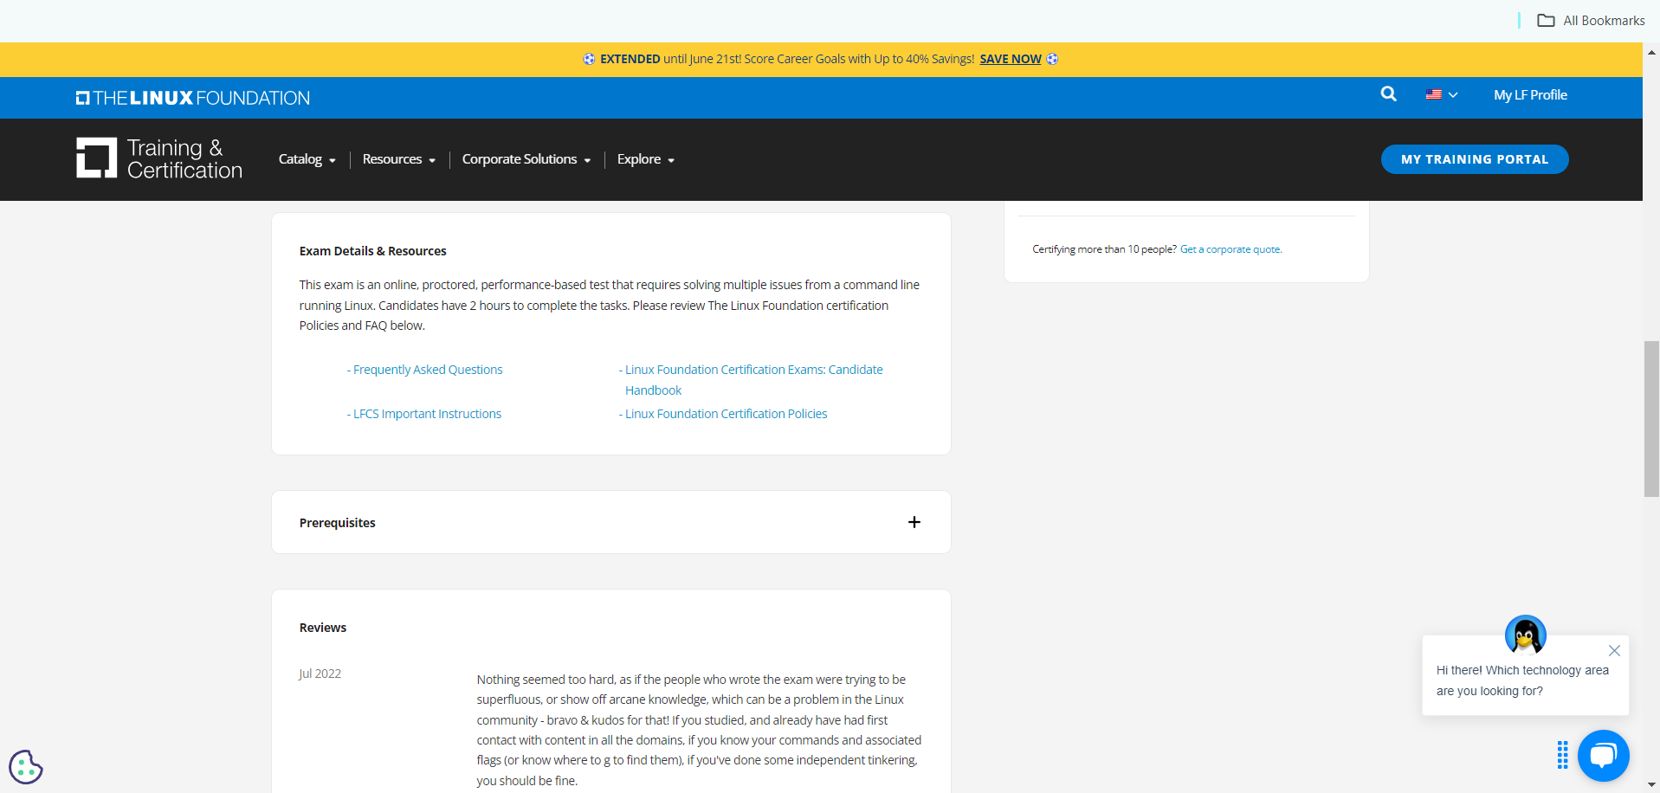
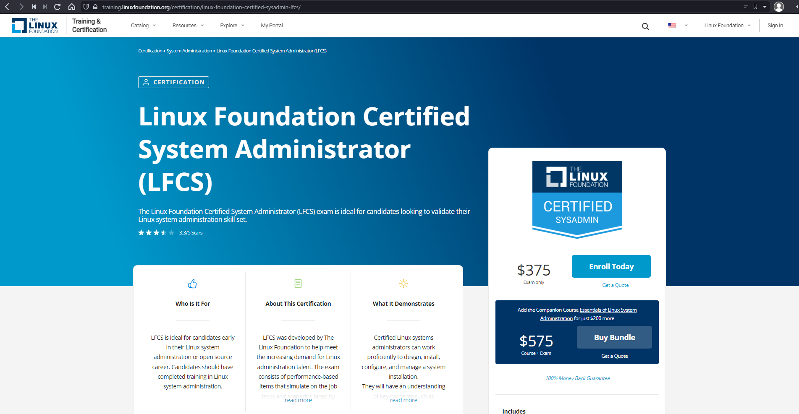
Conclusion
Notes:
Remember, you'll need to create an account with the Linux Foundation and purchase your exam voucher before taking the exam. If you still need to do this, you can go to training dot linux foundation dot org, forward slash certification, forward slash Linux dash foundation dash certified dash sysadmin dash LFCS and click "Enroll Today." Also, make sure you've read the candidate handbook, FAQs, and other information in the "Exam Details & Resources" section on the certification page.

Slide 163
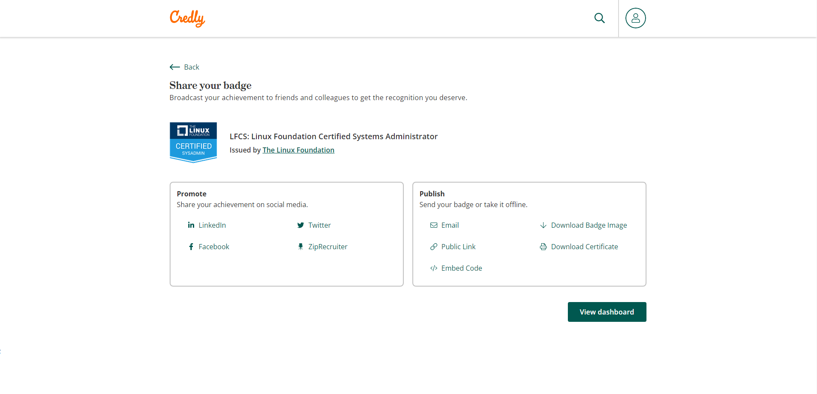
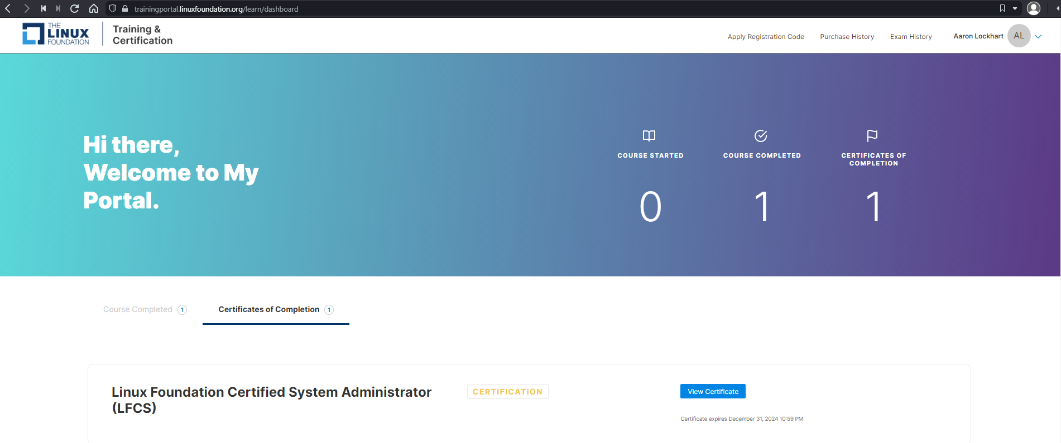
Conclusion
Notes:
Once you've passed your LFCS exam, the Linux Foundation will email you to let you know. You'll be able to view your score results through your training portal account. You'll also receive a digital badge through the Credly platform to show off your credentials on social media, in resumes, or on your website. I hope you enjoyed this course as much as I enjoyed teaching, and I wish you all the best for your exams. Good luck!

Slide 164



Share
We would be absolutely thrilled if you took a selfie with your class and share it on social media while tagging us.

Slide 165



Win KodeKloud Merch for your Team
Talk to us for a chance to win exclusive KodeKloud merchandises for your team.
Just fill this form out
Or email: teachlikeus@kodekloud.com

Slide 166
Note It’s best to work with this file in Powerpoint on Desktop
You can't see sections in the web version :-(
If you are not signed in to Microsoft account, please sign in first. Signing in with an account helps others know what changes you are making and helps better collaborate.
The click on the “Editing” dropdown and select Open in Desktop App
Note: If you are not signed in this option will not appear.
If you do not have a Desktop Powerpoint application you may continue to use this browser version.
All the best!

